Slide 1
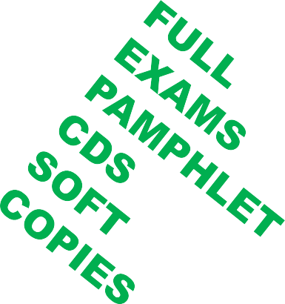
VynTex Technologies
A new Era in Education.
www.vyntextechnologies.co.ke
34

Slide 2
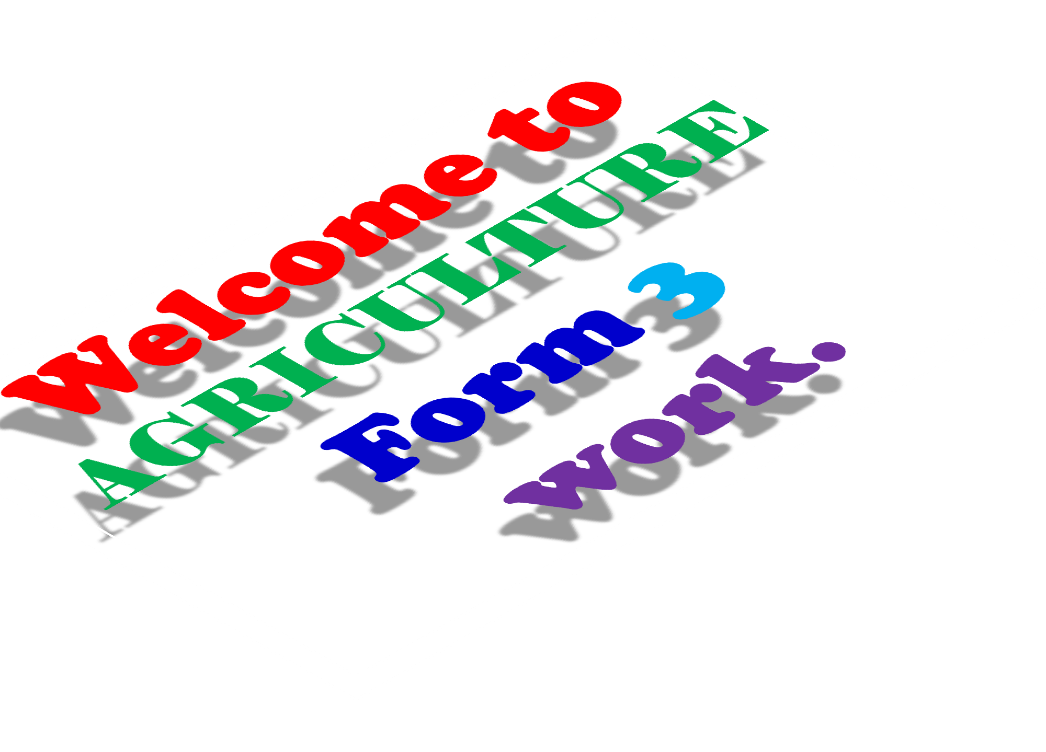
34

Slide 3
Please note the following
All form three agriculture work is covered in this slides and this is not summary.
All form three notes are covered in all the slides as in KLB book.
We also provide other resources
just visit my website www.vyntex.co.ke
0710250520 or 0743939160
0710250520
vyntex technologies
@vyntextechnologies.
34

Slide 4
CH1 LIVESTOCK PRODUCTION III 443/ 2
(SELECTION AND BREEDING)
•
REPRODUCTION AND REPRODUCTIVE
SYSTEM.
Reproduction-is the process by which offsprings are produced. The process starts with fertilization where the female gamete (ovum) unites with the male gamete (sperm) to form a zygote.
34

Slide 5
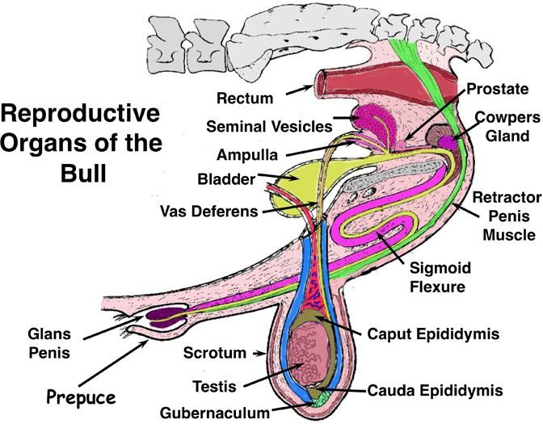
•
•
REPRODUCTION IN CATTLE.
The male reproductive system (Bull)
34

Slide 6
It consists of the following:
Testis.
Epididymis.
Sperm ducts.
Accessory glands (seminal vesicles and prostate gland.)
Penis.
34

Slide 7
Testis-they produce sperms which are stored in the coiled tube called epididymis.
Sperm ducts-they carry the sperms to the urethra that also forms part of the urinary system.
Seminal vesicles-produce a clear sticky fluid
called semen.
Prostate glands- produce a fluid that neutralizes the acidic effects of urine in the urethra hence preventing the death of sperms.
The penis-introduces sperms into the vagina of the cow through the vulva during mating.
34

Slide 8
•
The female reproductive system (Cow)
It consists of the following:
Ovaries.
Fallopian tubes (oviduct)
Uterus.
Vagina and the vulva.
34

Slide 9
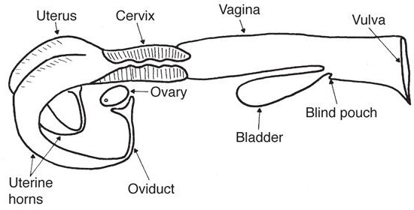
34

Slide 10
Ovaries-they produce ova, the female gametes. They also produce hormones to control the sex cycles.
Fallopian tube or oviduct-is where fertilization takes place as the ovum moves to the uterus.
Vagina and vulva-the vulva allows mating to take place so that the sperms are deposited into the vagina. The vagina is used for removal of urine and foetus.
34

Slide 11
Pregnancy.
It is the period between fertilization of the ova and the expulsion of the foetus through the vulva.
Parturition.
It is the act of giving birth.
Signs of parturition in animals.
Distended udder that produces a thick milky fluid called colostrum.
Swollen vulva producing thick mucus like discharge.
Loose and slackened pelvic girdle.
Visible pin bones.
General restlessness.
34

Slide 12
•
REPRODUCTION IN POULTRY.
The reproductive system of a hen consists of the following parts:
Ovary.
Funnel (infundibulum)
Magnum.
Isthmus.
Uterus.
Vagina.
Cloaca.
34

Slide 13
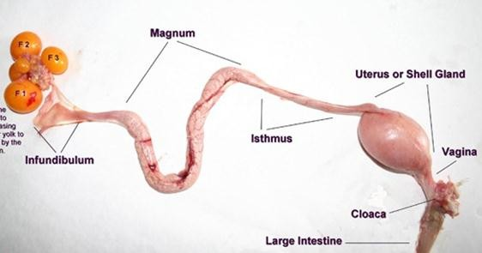
Ovum
Ovary
34

Slide 14
The ovary-eggs (ova) are formed in the ovary.
The funnel (infundibulum)-when the egg is moving down the funnel, fertilization takes place. At this time chalazae are added to hold the yolk. Ovum stays here for a quarter an hours.
Magnum-thick albumen is added here. The egg stays here for three hours.
Isthmus-when the yolk reaches here the shell
membranes are added. Water, mineral salts and vitamins are also added. The egg stays here for a quarter an hour.
34

Slide 15
Uterus (shell gland)-the uterus has calcium deposits hence the shell is added round the egg. Shell pigments are also added. Albumen addition is completed. The egg stays here for 18-22 hours.
Vagina-the egg is temporarily stored here before it is laid.
Cloaca-the egg moves out of the cloaca through the event.
34

Slide 16
SELECTION.
Selection is the process of allowing certain animals to be parents of the future generation while culling the others.
The animals retained/selected have certain desirable characteristics that make them produce more.
34

Slide 17
•
State and explain the factors considered when
selecting a breeding stock.
Age-young animals are selected because they have a longer productive life. Old animals are low producers and poor breeders.
Level of production-animals with the highest production performance such as high milk, wool and egg production should be considered during selection. Animals with poor performance should be culled.
34

Slide 18
Physical fitness-animals selected should be free from any physical defects such as limping, irregular number of teats etc as it is likely that these characteristics could be easily passed to the offsprings.
Health-selected animals must be healthy as sick animals do not breed well and are expensive to keep. Animals resistant to diseases pass the traits to their offsprings.
34

Slide 19
Body conformation-animals for breeding should be selected based on their proper body conformation e.g. a dairy animal should be wedged shaped.
Temperament or behaviour-some animals have bad temperament or undesirable behavior such as cannibalism and egg eating, aggressiveness. Such animals should be culled.
Quality of products-select animals that give products of high quality.
34

Slide 20
Mothering ability-animals selected should have a good mothering ability i.e. should have the natural instinct towards their young ones.
Adaptability-animals selected should be well adapted to the prevailing climatic conditions of the area.
Prolificacy-selected animals should be highly prolific, i.e. they should have the ability to give birth to many offsprings at a time.
34

Slide 21
•
METHODS OF SELECTION.
Mass selection-this method involves choosing animals for breeding on the basis of their own performance and then mating them at random.
Progeny testing-in this method a group of progenies (offsprings) are used as a help to increase the accuracy in the selection of a breeding stock.
Contemporary comparison-it involves a comparison of the average production of the daughters of each bull with that of the other heifer referred to as contemporaries in the heard.
34

Slide 22
BREEDING.
Breeding is the process of mating selected males and females in certain animals to produce offsprings of the required characteristics.
•
Give five reasons for breeding animals.
To expand the inherited potential of the animal.
To satisfy the consumer’s taste.
To overcome production problems created by the environment.
Breeding introduce new genes making the animal better in production.
For economic reasons.
34

Slide 23
•
BREEDING SYSTEMS.
Breeding systems are categorized into:
Inbreeding.
Outbreeding.
•
Inbreeding
.
It is the mating of animals that are closely related.
•
Reasons for inbreeding.
To increase genetic uniformity in the herd.
Used to fix the required characteristics in the new breeds.
34

Slide 24
To increase phenotypic uniformity. It helps to describe the external characteristics of a certain breed such as black and white colour in fresians.
Used to get proven sires. These are males that have been confirmed and proven to have very high quality through backcrossing.
Used in animals of high prepotency. Inbreeding is a sure method of testing whether an animal has high ability of passing its desirable characteristics to the offspring.
34

Slide 25
•
Disadvantages of inbreeding.
Inbreeding can bring loss of hybrid vigour.
May lead to decline in fertility leading to species extinction.
Bring about reduction in performance.
Leads to high rate of pre-natal mortality.
34

Slide 26
•
Systems of inbreeding.
Close breeding-refers to the breeding of very closely related animals
Line breeding-this is the mating of distantly related animals that share a common ancestor.
•
Outbreeding.
This is the mating between animals that are not related.
34

Slide 27
•
Reasons for outbreeding.
To introduce new genes in an existing breeding herd.
To exploit heterosis that is hybrid vigour, across- breed performs better than the average of the two parents.
To establish a new breed or a grade animal.
34

Slide 28
•
Systems of outbreeding.
Outcrossing-is the mating of unrelated animals within the same breed e.g. serving a fresians cow in Kenya with the semen of a fresians bull from Britain.
Cross breeding-it is the mating of two animals to form different breeds.
Upgrading (grading up)_it is a type of crossing
where the female of low grade stock is mated with a pure bred sire.
34

Slide 29
•
•
•
MATING IN LIVESTOCK.
Mating in cattle.
Signs of heat in cattle.
Restlessness-animals move here and there.
Mounting other and when mounted on it stands still.
Slight rise in body temperature.
Milk yields drops slightly in lactating cows.
The vulva swells and become reddish.
Clear or slimy mucus from the vagina.
Bellowing or mooing frequently.
34

Slide 30
•
•
Mating in pigs.
Signs of heat in pigs.
Restlessness.
Frequent urination.
Swollen vulva.
Clear or slimy mucus discharge from the vulva.
Frequent mounting others.
It responds positively to the riding test.
34

Slide 31
•
•
Mating in rabbits.
Signs of heat in rabbits.
Restlessness.
Frequent urination.
Swollen vulva.
The doe throws itself on its sides.
She rubs herself against the wall or any other solid objects.
The doe tries to contact other rabbits in the next hutch by peeping through the cage walls.
34

Slide 32
•
METHODS OF SERVICE IN LIVESTOCK.
Natural mating.
Artificial insemination.
Embryo transplant.
•
Natural mating.
It is the use of a male animal to serve a female.
34

Slide 33
•
Advantages of natural mating.
It is more accurate as males detect when the female is on heat increasing chances of conception.
It is less laborious as there is no need of checking the animals for heat signs.
Useful when heat periods of females cannot be easily detected.
•
34

Slide 34
•
Disadvantages of natural mating.
High chances of inbreeding or inbreeding is not easily controlled.
Males need extra pasture to eat that would have been used by females.
It is possible to transmit breeding diseases such as brucellosis or parasites.
Large males can injure small females.
A lot of semen is wasted as single ejaculation produces semen that can serve several females.
Expensive to transport bulls to serve cows.
34

Slide 35
•
Artificial insemination.
Refers to the introduction of semen into the female reproductive tract by hand using syringes or tubes
The semen collected is used to inseminate many cows.
34

Slide 36
•
Advantages of artificial insemination.
Semen from a superior bull can be used to serve many cows.
It controls the transmission of breeding diseases and parasites.
It is easy to control inbreeding.
It prevents large bulls from injuring small cows.
Sires that are unable to serve cows due to heavy weight or injury can produce semen to serve cows.
It reduces expenses of keeping a bull on pasture and veterinary bills.
34

Slide 37
Small scale farmers who cannot afford to buy a superior bull can have the cows served at a very low cost.
Semen can be stored for a long time even after the death of a bull.
It is easy to control breeding i.e. a person can time when to breed his cows.
It eliminates dangerous bulls from the farm
34

Slide 38
•
Disadvantages of artificial insemination.
Requires skilled labour.
Low chances of conception because semen can die due to storage problems.
Requires more labour than natural service.
Harmful characteristics can be spread quickly by one bull to the offsprings.
34

Slide 39
•
Embryo transplant.
This is a technology where ova (eggs) are harvested from high quality animals, fertilised in test tubes and then embryos that develop are implanted into foster mother.
•
Advantages of artificial insemination.
o Possible to implant embryo from high quality female to less valuable females hence improving the performance of the offspring.
34

Slide 40
Stimulates milk production in a female that was not ready to produce milk.
A highly productive female can be spread over a large area to benefit many farmers.
It is easier to transport embryos in the test tubes than the whole animal.
Embryos can be stored for long periods
awaiting availability of a recipient female.
34

Slide 41
•
Disadvantages of artificial insemination.
The technology is expensive.
It requires trained personnel to handle and administer.
Requires special equipment for fertilization.
34

Slide 42
Signs of parturition.
•
•
Signs of parturition in cattle(calving down.)
(Gestation period of 270-285 days)
Restlessness.
Enlarged or swollen vulva.
Clear mucus discharge from the vulva.
Slackening of the pelvic muscles.
Full and distended udder.
Thick milky fluid from the teats.
A water bag appears and bursts just before calving.
34

Slide 43
•
Signs of parturition in pigs(farrowing). (Gestation
period of 4 months)
Becomes restless.
The vulva turns red and swells.
Udder becomes full with a milky fluid.
Sow starts to build a nest by collecting bedding at one corner of the pen.
•
Signs of parturition in rabbits (kindling).
(Gestation period of 29-33 days)
Doe starts nest building by plucking off hair from her belly.
Goes off feed.
34

Slide 44
CH 2 LIVESTOCK PRODUCTION IV
443/ 2.
(Livestock rearing practices)
•
ROUTINE LIVESTOCK REARING
PRACTICES.
Feeding practices.
Animals are fed to cater for both maintenance and production.
In certain periods animals are fed with specialized feed.
Such periods include flushing, steaming up or when feeding young animals.
34

Slide 45
a)Flushing.
It is when a high plane of nutrition is given to the animals around service time.
•
Importance of flushing.
Increases conception rate due to higher ovulation rate.
It facilitates implantation of the zygote.
Flushing increases lambing percentage by 15 to 20% in sheep.
34

Slide 46
a)Steaming-up.
It is the practice of providing extra feed of high nutritive value to an animal during the last weeks of gestation.
•
Importance of steaming-up.
Provides nutrients for maximum foetal growth.
Helps to build up energy for parturition.
Ensures birth of a healthy animal.
Promotes good health of the mother.
Increases and maintains high milk yield after birth.
34

Slide 47
a)Creep feeding.
It is the feeding of young animals from birth to weaning.
•
Reasons for creep feeding.
✓.
✓.
✓.
✓.
34

Slide 48
❖
Parasites and disease control practices.
a)
Vaccination.
Refers to the process of introducing active disease organisms reduced in strength or virulent into an
animal’s body.
•
Vaccines are administered/given to animals in the
following ways:
By injection.
Orally through the mouth.
By inhalation, through the nose.
Through the cloaca.
34

Slide 49
Vaccines are grouped as follows:
Live virulent vaccines- are living organisms capable of causing diseases to an animal. They stimulate production of antibodies against it.
Live attenuated vaccines-are disease causing organisms whose ability to cause the disease has been reduced.
Killed or dead vaccines-are disease organisms that are completely killed by the use of formaldehyde or phenol.
Toxoids- are vaccines made from toxins.
34

Slide 50
•
Properties of a good vaccine.
Should have a long keeping life i.e. its shelf life should be longer.
Should be easy to administer to the animal.
It should produce immunity that is as good as natural immunity.
It should have no side effects when inoculated.
It should be compatible with the other vaccines given to the animal.
A single dose of the vaccine should produce lifelong immunity.
34

Slide 51
Care and handling of vaccines.
Vaccines should be kept under freezing temperatures of between 20 to 4 degrees Celsius.
Vaccine equipment should be sterilized.
Correct dosage should be adhered to.
The route of administration should be correct.
34

Slide 52
b) Deworming.
Deworming is carried out to control internal parasites.
It is done using equipment such as dosing gun, bolus gun or narrow necked bottle.
c) Hoof trimming.
It is the cutting back of overgrown hooves.
It is done using hoof trimming knife, a hoof cutter and a hoof rasp.
34

Slide 53
Reasons for hoof trimming:
To facilitate easy movement.
To control foot rot disease.
To prevent the ram from injuring the ewe during tupping
d) Docking.
It is also called tailing.
It is the removal of tail or dock.
34

Slide 54
•
Reasons for docking.
To facilitate tupping or mating.
To give a good fat distribution throughout the body.
To prevent blowfly infestation.
•
Methods used in docking.
Elastrator and rubber ring.
Burdizzo and knife.
Knife.
Hot iron.
34

Slide 55
e) Dipping and spraying.
They are done to control external parasites such as ticks, lice, mites and fleas.
External parasites suck blood and some transmit diseases.
Plunge dips are used for large stocks like cattle whereas spraying is done with appropriate chemicals can be done.
34

Slide 56
f) Dusting.
It is a method of application of chemicals to control external parasites.
Used when chemical powders have to applied by rubbing into the animal skins or applied to the house where animals are usually confined.
A tool called a duster is used to spread the chemical powders evenly.
34

Slide 57
Breeding practices. a)Crutching and ringing.
Crutching is the cutting of wool around the external reproductive organs of a female sheep to facilitate mating and to prevent infections.
Ringing is the trimming of wool around the sheath of the penis of the ram to facilitate mating.
34

Slide 58
b) Tupping and serving.
Tupping refers to the act of mating in sheep and goats.
Serving refers to mating in cattle and pigs.
c) Raddling.
Raddling is the practice of fitting the rams with breeding chutes which are painted in different colours during breeding.
The paints help to identify the ewe that have been served and y which ram
34

Slide 59
d) Identification.
Identification of animals is important as it facilitates the carrying out of the following practices.
Selection and breeding.
Diseases control and treatment.
Feeding.
Record keeping.
Culling.
34

Slide 60
•
Methods of identification.
i.
Branding
It is the marking of animals on the skin using permanent marks usually by use of a hot iron.
This method causes a lot of pain to the animal and also reduces the quality of the hides and skins.
Best sites for branding should be below the hock or on the side of the animal’s jaws.
34

Slide 61
ii. Ear tagging.
A method where plastic or metal tags bearing numbers or letters are fixed through a hole perforated on the ears of the animal.
The tags are fixed using an ear tagger.
Iii Ear notching.
Ears of the animals are perforated through to make different shapes in different positions.
The shapes stands for certain value and when all
the values represented by the shape are added together they give the number or identity of the animal.
34

Slide 62
iv.Tattooing
Tattoos are shapes, numbers or letters that are made on the skin with a permanent ink or dye.
A tattooing machine is used to make the tattoos.
Tattoos are made on areas of the skin which are light coloured such as the ear, udder or the muzzle.
v. Neck strap or chain.
o In this method, a piece of metal or wood made
into different shapes and numbers or letters is hang and suspended around the neck with a canvas, leather strap or metal chain.
62

Slide 63
e) Debeaking.
A practice carried out in poultry to control vices such as cannibalism and egg eating.
During Debeaking, ¹ /₃of the upper beak is cut
using a debeaker, knife, scissors or hot iron.
f) Tooth clipping.
o Is the removal or clipping off of the needle teeth called canine teeth or fangs.
g. Culling.
o It is the removal of unproductive animals from a breeding herd to live a high quality and productive animals.
63

Slide 64
•
Reasons for culling animals.
Poor health.
Age.
Poor production.
Have physical deformities.
Poor mothering ability.
Have hereditary defects.
To avoid inbreeding.
Incapability of producing young ones.
63

Slide 65
h) Dehorning.
It is the removal of horns or horny buds from animals.
•
Reasons for dehorning.
To prevent cattle from inflicting injuries to other.
To make animals docile and easy to handle.
For easy transportation and feeding-polled animals occupy small space in transportation and feeding.
To prevent destruction of farm structures
63

Slide 66
•
Methods of dehorning.
Use of caustic potash stick (potassium hydroxide)
Use if disbudding iron.
Use of dehorning saw or wire.
Use of rubber ring and elastrator.
Use of dehorning colloidon.
63

Slide 67
i) Shearing.
It is the cutting of wool from all over the body of a wool breed of sheep.
A wool shear is used for shearing.
j) Castration.
It is the rendering unserviceable the testicles of a male animal.
•
Reasons for castration.
To control breeding diseases such as brucellosis, vaginitis, trichomonias etc.
To control breeding.
To increase quality of the meat by removing unpleasant smell especially in goats.
63

Slide 68
•
Methods of castration.
Closed methods-involves no cutting of the skin and bleeding does not occur includes:
Use of elastrator and rubber ring.
Use of a Burdizzo.
Open method. (use of knife or scalpel)-it is a surgical method used for castration. Involves:
Knife or scalpel.
Caponisation-is the acts of making birds lose their male characteristics.
63

Slide 69
Management during parturition.
•
The act of giving birth to a fully grown foetus is known as parturition.
The act of parturition is given different terms in different animals as indicated in the table below.
Animal | Parturition term used.
Cattle | Calving or calving down.
Pigs | Farrowing or farrowing down
Sheep | Lambing or lambing down
Goats | Kidding or kidding down
Rabbits. Vyntex tech | nKologiines dling or kindling down. /0743939160 ⁶⁹
0710250520

Slide 70
•
Parturition in cattle. (Calving)
Cattle have gestation period of about 270 to 285 days.
When the cow shows sign of parturition it should be separated from the rest of the herd and put in a paddock or stall.
12-24 hours before calving labour pains occur and the cow becomes very nervous and restless.
A water bag appears and bursts before calving.
81

Slide 71
Normal calving should take 2 hours and the normal presentation is where the muzzle, face or forehead on top of the forelegs comes out first.
Afterbirths should be expelled within 5 hours after birth but if retained more than 48 hours the veterinary should be called to provide antibiotics that prevent infections.
81

Slide 72
•
Parturition in sheep. (Lambing)
Lambing in sheep occurs after 21 weeks or 150 days.
Ewes should be placed in open clean pens that are free from draught and away from f other animals to avoid disturbance, trumpling on by other animals.
Types of lambing.
Drift lambing-it is where all pregnant ewes are put together in one paddock and then separated as they lamb-down.
Pen lambing-it is where ewes are only separated from the others showing signs of lambing and put in their own individual clean pens to lamb down under supervision
81

Slide 73
Signs of lambing.
•
Restlessness.
Slackening of the hip muscles.
Udder becomes full and the teats are bright red in colour.
•
Parturition in goat. (Kidding)
The gestation period in goats lasts for 150 days.
Signs of kidding in goats.
Udder becomes firm and teats enlarge.
Muscles at either side of the tail slacken.
Restlessness.
Separating itself from the rest of the flock.
A clear discharge from the vulva.
81

Slide 74
•
Parturition in pigs. (Farrowing)
Pigs have a gestation period of 4 months or 113 to 117 days.
Preparations should start 7-10 days before expected date of farrowing.
Farrowing pens should be cleaned and disinfected.
Dry warm beddings with farrowing crates should be introduced.
81

Slide 75
The pig should be drenched to control internal parasites.
Clean the skin with soap and water to remove all external parasites.
Sow should be brought in the farrowing pen about 3 days before the expected date to:
Familiarize herself with new environment.
Avoid inconveniences of transferring the piglets in case of early farrowing.
81

Slide 76
•
Signs of farrowing.
Sow becomes restless.
There is enlargement of the vulva.
Muscles on each side of the tail slacken.
There is loss of appetite.
The udder and the teats become enlarged.
Sow collects bedding materials at one corner to build nest.
81

Slide 77
Parturition in rabbits. (Kindling)
•
Gestation period of rabbits is 28-32 days.
Place a nest box and dry soft bedding into the hutch towards the 4th week of gestation.
•
Signs of kindling.
Doe plucks off the fur from her body.
Uses the fur to build a nest about 3 to10 days earlier.
81

Slide 78
BEE KEEPING. (APICULTURE)
•
Bees are kept for the following reasons.
Production of honey.
Bees are good pollinators for many crops.
They require little capital and land to keep.
81

Slide 79
•
Types of bees.
o Bees are of two types namely: the African wild bee and the European bee.
•
Characteristics of the African wild bee. (apis
mellifera adansoni.)
Well adapted to local weather conditions such as high temperatures.
Has high flying power and can fly for long distances.
It is more active in search of food and water.
It is vicious if manhandled.
Fairly resistant to the diseases
81

Slide 80
The bee colony.
Bee colony is made up of three types of bees as follows.
1.
The queen.
it is a female bee that has the following functions in the hive:
Lay fertile eggs.
Keeping the colony together by production of a pheromone called queen substance for identification.
81

Slide 81
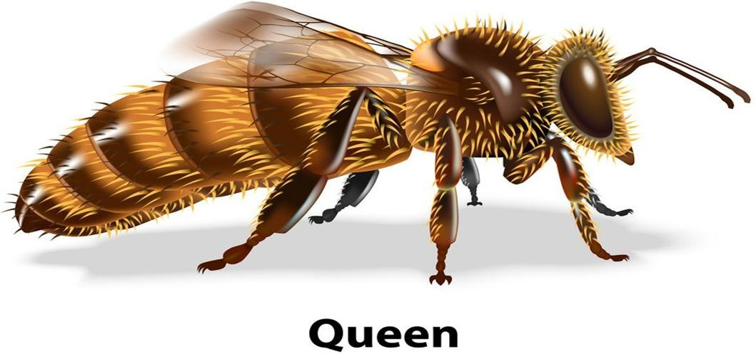
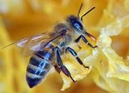
81

Slide 82
2.
The drones.
They are about 300 in a colony.
They have the following functions:
To fertilise the queen.
To control the temperature or to cool the hive by flapping their wide wings at a very high speed.
81

Slide 83
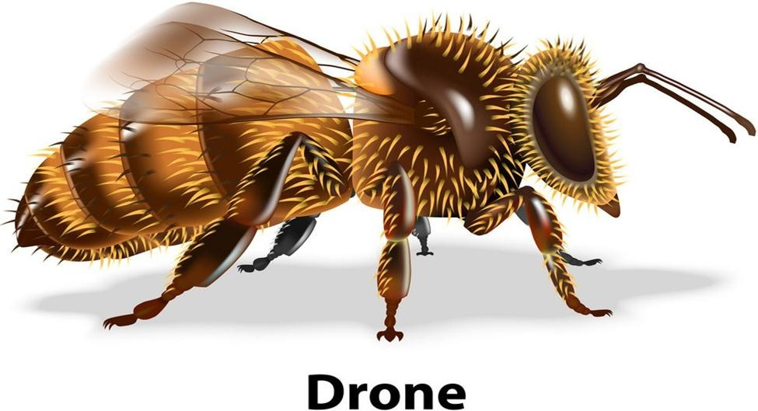
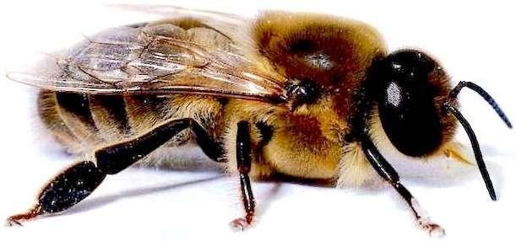
81

Slide 84
3.
The worker bees.
They are about 60,000 in number.
They are the smallest and are normally female bees.
They perform the following functions:
To feed the queen, the drones and the brood.(young bees).
To protect the hive from intruders.
To collect nectar, pollen, trees resins, gums and water.
To build combs and seal the cracks and crevices in the hive.
To clean the hive.
To make honey and beeswax.
81

Slide 85
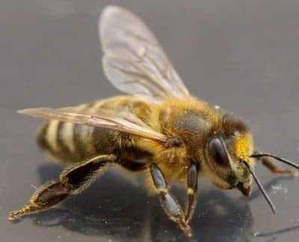
Worker bee
85
Vyntex technologies 0710250520/0743939160

Slide 86
•
Siting of an apiary.
An apiary is a place where beehives are laid.
When sitting an apiary the following factors are considered:
Availability of water-water should be within a radius of 3 km or supply a sugar solution close the hive.
Availability of flowers
A sheltered place-hives should be protected from strong sun and wind.
A place that is free from noise and disturbances
Away from human beings and busy roads.

Slide 87
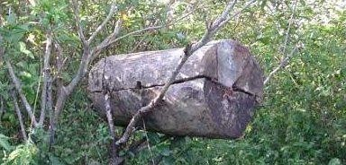
•
Types of Bee hives.
a)Log hive.
It is made from log that is split into two parts one being larger than the other.
The larger part is made into a trough-shaped structure by removing the inner tissues of the stem using a sharp chisel.

Slide 88
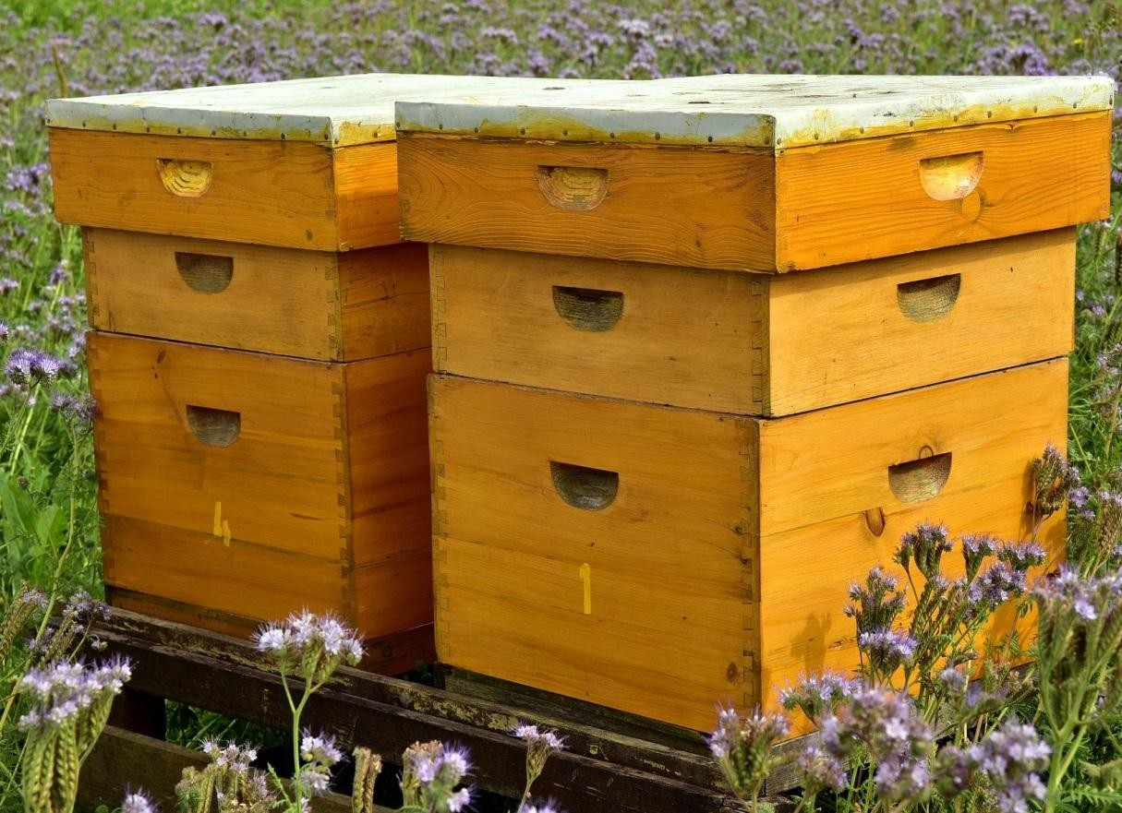
b) Box hive.
Made from sown timber cut to a length of one meter. The top side end board are nailed together while bottom board is attached by means of wires or supported by four small pieces of timber that are easy attached.

Slide 89
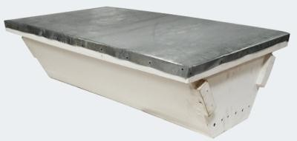
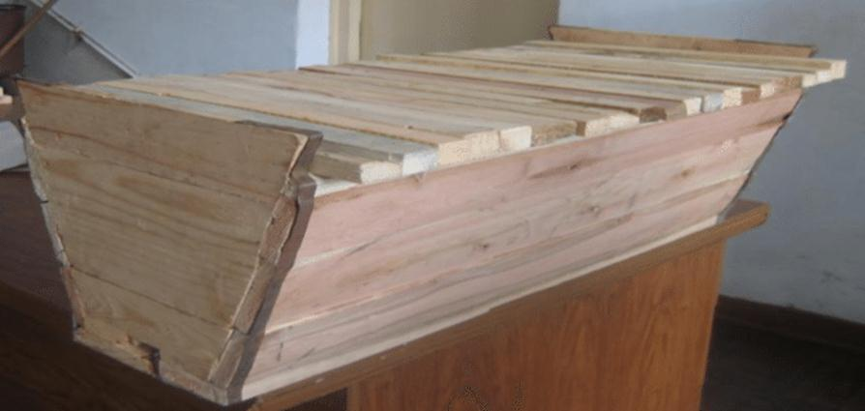
c) Kenya top bar hive. (K.T.B.H).
It is a movable frame hive designed to have a series of bars arranged to form the top of the hive where bees attach their combs to the bars which can be removed for examination. These bars are called top bars.

Slide 90
•
Give seven advantages of the top bar hive.
Top bar can be removed for inspection of the combs and replaced.
Honey combs can be removed without disturbing the brood.
Honey is of high quality as it is harvested without brood combs.
More wax is harvested as combs are not returned to the hive.
The hive is easy to construct and repair.
The hive is cheap to build and does not require expensive equipment to extract honey.

Slide 91
d) The langstroth hive.
It is like a box hive designed with separate chambers for the brood and the honey
Stocking the Hive.
This is the act of encouraging bees to enter an empty hive or actually putting them in it.
•
Methods used in stocking a hive.
Use of a swarm net.
Use of a catcher box

Slide 92
•
Materials collected by Bees.
Nectar- used as the main food for bees and in making honey.
Pollen-used by bees to feed the brood and the queen.
Propolis-Used to fill in cracks and crevices in the hives.
Water-essential for survival of bees. Should be put near the hive in containers. Pieces of sticks should be floated to prevent bees from drowning.

Slide 93
•
Feeding Bees
Bees feed on nectar and pollen from flowers. In absence of flowers they are fed on sugar syrup placed near the hive.
Give three reasons for feeding bee.
To maintain the colony.
To encourage multiplication.
To supplement what bees get from flowers.

Slide 94
Pest, disease that attack bees and their control. a)Ants.
They enter the hive through climbing plants and make holes in the hive that allows water into the hive which causes rotting.
Controlled by:
-avoiding contact between a plant and hive.
-suspend the hive with wires between poles which are coated with old engine oil to keep off the ants.

Slide 95
b). Wax moth.
They make tunnels in the combs and contaminate honey with their excreta.
Controlled by -removing and burning all infected combs.
-Immediately melting old combs or wax left after harvesting honey.
c). Bee louse.
It is a parasite of the bees.
Larvae hatched in the wax spoil the combs.
Controlled by:-smoking out the hive using a smoker that has some creosote to control the pest.

Slide 96
e) Honey badgers
They spoil hives and eat honey.
Controlled by: hanging the hives with wires to swing when badgers climb on them. It makes the badgers to fall hence discouraging them.
•
DISEASES.
Bees are commonly attacked by two diseases namely:
Acarive.
American foul brood
This diseases are controlled by proper feeding of bees and proper construction of the hives to prevent damp conditions in the hive.

Slide 97
•
Swarming of Bees.
Give seven reasons why bees may swarm.
Shortage of food and water in their surroundings.
Outbreak of diseases and parasites.
Damage of the brood combs.
Lack of adequate ventilation.
Dampness and bad smells.
Sick or infertile queen.
Overcrowding.

Slide 98
•
Describe the procedure of harvesting honey.
Quietly approach the honey and blow the smoke around the hive and later through the holes using a smoker.
Lower the hive to the ground.
Cut the combs from each top bar 3 cm from the surface and put them in a clean container.
Place back the bars and do not disturb the brood.
Return the hive to its position.

Slide 99
•
Equipment used in Harvesting of honey.
A protective gear.
Honey container with a tight cover.
A hive tool-for scrapping Propolis holding the top bars.
Bee brush- used to brush of bees from honey combs before cutting into container.

Slide 100
•
•
HONER PROCESSING.
Methods of processing Honey.
Using heat to melt honey.
Crushing and straining.
Using a centrifugal extractor.

Slide 101
a)
Heat method.
Heat some water in a sufuria.
Put honey combs in an enamel basin or any container that is not made of iron.
Put the container with honey comb on the boiling water.
Heat until most of the honey melts.
Separate the melted honey from the combs by straining through a muslin cloth.
Keep honey in a container to cool down.
Remove the wax layer that may form on the surface of the honey.

Slide 102
a)Crushing and straining method.
Honey combs are crushed and strained using a muslin cloth into the enamel basin.
The scum formed is removed with a wooden spoon.
Honey is put in a suitable container which is tightly closed.
a)Use of centrifugal extractor.
Used in large scale production of honey where combs are forced in a rotary motion forcing out honey as combs are left clean.
102

Slide 103
•
Uses of Bee wax.
To manufacture creams, ointments, candles, shoes and floor polish.
Used to make teeth impressions for filling and replacement in dentistry.
Used in the dissection of small insects in laboratories.
Used to make pill coatings in pharmaceuticals.
•
Highlight any four factors that determine the quality
of Honey.
The type of plants from which the nectar was obtained.
Maturity stage of honey at the time of harvesting.
The method of harvesting.
The method of processing honey.

Slide 104
•
FISH FARMING.
The artificial rearing of fish in ponds is called fish farming or aquaculture.
•
Importance of Fish farming.
Supplies a cheap and good source of proteins.
Can be practised even where land is a limiting factor because it requires little land.
It makes fish available nearby.
It is a source of income for the fish farmers.

Slide 105
•
Requirements for fish farming.
Water supply-freely flowing water.
Slope of the land-a gentle slope is suitable .
Soil- clay soil is preferred as it does not allow water to seep through.

Slide 106
•
Establishment procedure of a fish pond.
Site selection-suitable place where water flows gently from the source.
Site marking- use of pegs to mark the channel from the river ,the entrance and the exit.
Clearing the land- remove all vegetation.
Digging the pond-soil is dug out and the top soil placed in a particular place as it will be used again.
Constructing the dyke-dyke is the wall constructed all-round the pond.

Slide 107
•
Construction of inlets, outlets and spillway.
a)Inlets
A canal or a pipe at the entrance to the pond.
Should have a screen of dine mesh made a cross the inlet to prevent the entrance of undesirable or strange species of fish.
a)Outlet.
Made at deeper end of the pond above the bottom of the pond.
A screen is fitted at the mouth of the outlet to prevent the fish from swimming away.

Slide 108
a)Spillway.
It is a channel to allow excess water back to the river.
It is made at the top of the dyke on the lower side of the pond.
It prevents the water from over flowing on the dykes.

Slide 109
•
Stocking the pond.
Fingerlings (young fish) are obtained from hatcheries and introduced into the pond.
They are transported in oxygenated polythene bags or drums.
The water should be clean and at a temperature of 10 degrees Celsius.
Care should be taken to avoid injuring the fingerlings.
They are introduced in the pond by lowering the container into the water and tilting to allow them to swim away.

Slide 110
•
Feeding of Fish.
Most fish food is planktons.
Other feeds can include groundnut cake, kitchen waste, slaughter house waste, leaves, grass and manure and chicken manure.
Fish are given enough food as excess can rot and pollute the pond.
Feed change should be done gradually.
Manure should be added to the pond to encourage the growth of planktons.

Slide 111
•
Cropping and Harvesting of fish.
Cropping- is the removal of fish of marketable size from the pond.
Harvesting-is the removal of all fish from the pond.
•
Procedure of harvesting.
Inflow of water is stopped by closing the channel leading to the pond.
Normal cropping is done to remove all the large fish by use of a seine net.
The outlet is then opened to allow water to flow out.
A scoop net is used to catch baby fish that are kept in a holding pond.
Water is completely drained for the pond to dry up.

Slide 112
•
Maintenance of the pond.
Repair the dyke or any structure on it.
Cleaning the pond and removing all foreign materials.
Planting grass where necessary.
Removing undesirable vegetation.
Removing the silt.

Slide 113
Fish preservation.
After harvesting, the following practices are carried out on the fish.
Cleaning the fish to remove mud and any worms.
Removing scales and slime.
Gutting-Opening the fish on the sides to remove the gut and intestines.
Cleaning the abdominal cavity thoroughly.
Keeping fish in open containers.

Slide 114
•
Various methods for preserving fish.
Freezing-keeping fish in deep freezers
Salting-fish are kept in salt solution.
Sun-drying-fish are dried under strong sunlight.
Smoking-done to expose fish to a temperature of 70 degrees

Slide 115
CH 3 FARM STRUCTURES
443/2
•
What is a farm structure?
Refers to any physical construction found on the farm. Farm structure includes fences, crushes, dips, stores, calf pens, sheep, poultry houses, dairy sheds.
•
Construction of farm structures.
Construction of farm structures involves the following activities.
Planning.
Siting.
Site preparation.
Selection of planting materials.

Slide 116
i.
Planning of farm structures.
When planning for farm structures the following structures should be considered.
Accessibility.
Potential for expansion.
The size of the enterprise.
Various farm activities to be carried out.

Slide 117
ii. Siting farm structures.
•
State and explain 8 factors to consider when
siting(selecting a site for) a farm structure.
Location of the homestead -the site should be at a point where it is easy to have a good view of the farm.
Topography-the site for construction should be on a gentle slope to prevent flooding and soil erosion.
Accessibility-the structure should be sited where it is easy to reach from most parts of the farm.
Security- the structure should be safe from predators, thieves and trespassers.

Slide 118
Drainage-the location for the farm structure should have a good drainage to prevent structures from being destroyed by water. Presence of damp conditions also encourages disease infections.
Direction of the prevailing wind-some structures are able to produce foul smell e.g. pigsty. Such like structures should be constructed on the leeward side of the homestead.
Relationship with other structures-structures that are related for example dairy shed and calf pen should be constructed close to each other. This saves time and Labour.
Farmer’s taste and preferences-as a farmer’s prefers, she or he can construct the structure in a sheltered place
or not.

Slide 119
iii. Site preparation.
After planning and site selection, the site selected need to be prepared. Site preparation can be done through:
-clearing of bushes, grass and other vegetation
-leveling the ground.

Slide 120
•
Construction materials.
Construction materials include:
Stones:
Advantages
They are durable They are resistant to fire.
Resistant to weather elements
Resistant to insect damage
They do not rot.
Disadvantage
stones are expensive

Slide 121
Concrete blocks: made of cement, sand and ballast in ratio 1:2:3. The water used in the mixture should be free from impurities which reduces the binding ability of cement leading to poo quality blocks. They are durable
•
•
•
•
They are resistant to fire. Resistant to weather elements Resistant to insect damage They do not rot.

Slide 122
Other construction materials include concrete, mud blocks, bricks, corrugated iron sheets, bars and rods, aluminum sheets, and timber.

Slide 123
TIMBER-they are sued for poles, rails, trusses, purlins, struts and beams in construction. Timber is treated through the following methods:
Drying- also called seasoning. Drying is done to reduce moisture content. Drying prevents warping, rotting due to fungal attack and insect damage.
Chemical treatment-it is done through:
Sap displacement method-freshly cut posts are packed in containers filled with wood preservatives and left to stand in for 10 days.
Pressure or vacuum treatment-peeled wood is arranged in steel cylinder where preservatives are forced through them with very high pressure.
Hot and cold soaking-wood is immersed in tanks containing preservatives and heated for 2 hours

Slide 124
•
•
Selection of construction materials.
State seven factors to consider when selecting
construction materials.
Availability of materials.
Cost of the materials.
Durability of the materials.
Strength of the materials.
Workability of the materials.
Suitability of the materials.
Suitability of each material to prevailing weather conditions.
124

Slide 125
•
Types of farm structures.
Farm buildings-are structures that have the foundation, walls and the roof.
•
Give five importance of farm buildings.
They protect the farmer and livestock from predators.
Helps to control livestock diseases and parasites.
They provide shelter against extreme weather conditions.
They provide storage of farm produce.
Increase efficiency of production and management in the farms.

Slide 126
•
Parts of a building.
The foundation.
Depth and size of the foundation depends on function of the building, type of the building, depth of the soil and drainage of the area.

Slide 127
Describe the steps followed during the establishment of the foundation of a building
Clear the vegetation and level the site.
Foundation is measured, pegged and dug to remove all loose soil. (permanent buildings).
Reinforce concrete ration (1:2:4 or 1:3:6) in the trench.it may be together with steel rods.
A damp-proof course of PVC (polyvinylchloride) sheet is placed on top of the foundation to reduce termite and moisture rising up the wall. After compacting.
The foundation stone laid to about 15 cm above the ground level.

Slide 128
The wall
Walls are laid from the foundation in direct contact with the PVC materials. a plumb bob and spirit level are used to lay stones to ensure that the wall is vertical. A lintel is built to reinforce the wall above the windows and doors.
The roof.
The top part that consists of trusses and purlins on which the roofing materials are placed.

Slide 129
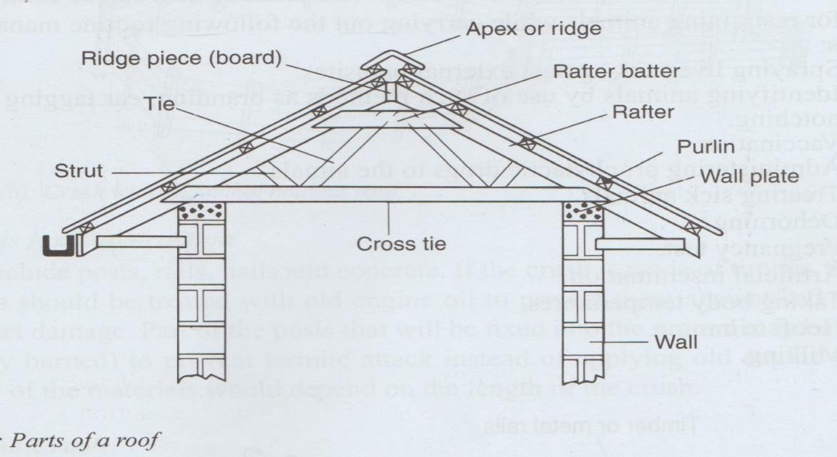
Eave
Gutter.

Slide 130
2.
Livestock structures.
They include:
Crush
Dips
Spray race
Dairy shed
Zero grazing unit
Calf pens
Poultry houses
Piggery unit
o fish ponds

Slide 131
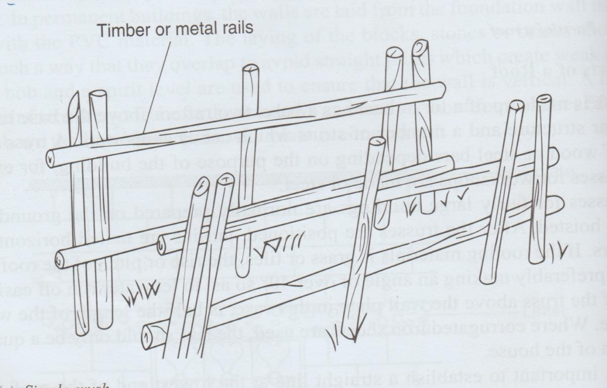
1. THE CRUSHES.
A crush is A narrow-fenced passage in which livestock movement can be controlled. It is used for restraining animals when carrying out the following practices.
A simple crush.

Slide 132
•
List 10 practices that are carried out in a crush.
Spraying.
Vaccination.
Dehorning.
Identifying animals through branding, ear tagging and ear notching.
When Treating sick animals.
Milking.
Hoof trimming.
Taking body temperatures.
Artificial insemination.
Pregnancy test.

Slide 133
NOTE; when sitting a crush, the following factors should be considered
Topography-well drained and relatively flat area.
Accessibility-should be an area easy to access or reach like near a road.

Slide 134
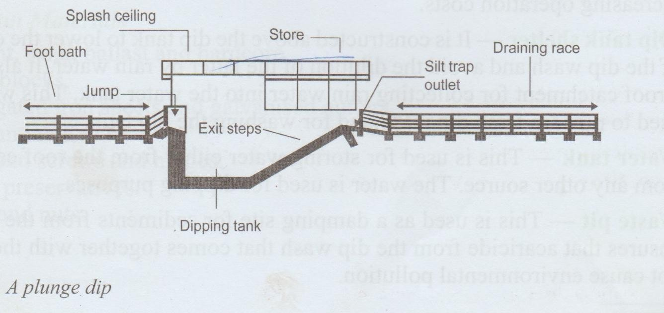
2. DIPS
A dip is a farm structure constructed to control ticks. Dips are of two types: plunge dip and the Machakos dip.
a)Plunge dip
To the drying yard

Slide 135
•
Parts of a plunge dip
Animal holding yard- it is used to hold animals before dipping. It should have concrete floor
/stones to ensure that mud from the hooves is removed before the animals get into the dip wash.
The footbath-its purpose is to wash the feet of an animal before they get into the dip wash. It should have a rough concrete floor to provide grip and also remove mud from the hooves for washing of the feet. It should contain chemicals (copper sulphate) for controlling foot rot disease.

Slide 136
The Jump- is a narrow entrance to the dip tank. Its function is to allow animals to jump singly (as one) into the dip tank. The jump must be above the dip wash by 35cm-45cm to allow dip wash to splash back in the dip tank.
Dip tank- it is here where animals are immersed in the dip wash. The dip tank should have exit steps to allow animals to come out of the dip wash slowly.
Draining race- a passage that animals used to walk out after immersion where the dip wash that drips from the animal’s body drains back to the dip tank. It should have a sloping floor that is smooth and without potholes towards the dip tank.

Slide 137
Drying yard-animals are held in the drying yard before being released to the pastures. This prevents pasture contamination and also allows animals to be released at the same time.
Silt trap outlet-this is where the mud and dung that drains back through draining race is trapped to prevent siltation in the dip tank.
Dip tank shelter-Constructed above the dip tank. The functions of the dip tank shelter are:
-to lower evaporation of the dip wash.
-to avoid dilution of the dip wash by the rain water.
-it serves as a roof catchment for collecting water into the dip tank.

Slide 138
Water tank-Used for storing water which is used for dipping purposes.
Waste pit- used as a damping site for sediments from the dip tank hence reducing pollution.
•
Maintenance of dips
Replace broken timber rails.
Clean the dip tank regularly.
Cracks in various parts of the dip tank should be repaired.
The roof should be maintained properly to avoid leakages that may dilute dip wash.

Slide 139
Give three advantages of using a plunge dip.
Animals are completely immersed in the dip wash ensuring that the whole body is wetted.
It is suitable for a large herd of animals.
Its operational cost is low.
Give the disadvantages of using a plunge dip.
It cannot be used for pregnant or sick animals as they can get shock.
Animals may swallow some dip wash resulting to death.
Initial capital is high as it is expensive to construct.

Slide 140
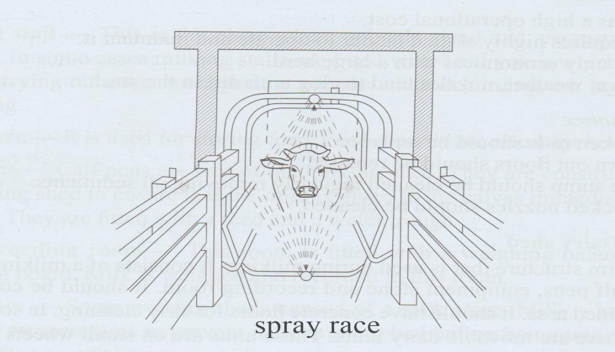
3. THE SPRAY RACE.

Slide 141
It is a farm structure used to control ticks on the farm. Here animals are showered with the acaricide from nozzles as they pass through a narrow passage. The acaricide is drawn from a reservoir under pressure through pipping and nozzles in the race.

Slide 142
•
Parts of a spray race.
Sidewalls-provide support to the piping system and ensues the spray wash is directed back to the pump.
Spray piping system-consists a series of pipes fitted with nozzles. They atomize the chemical into spray.
Drainage pipe-conducts the used chemicals back to the pump for recycling. It is fitted with sieves to that filter sediments and other particles to prevent blockage of nozzles.
The pump/ reservoir- is the mixing tank.
Pressure gauge-used to measure the recommended working pressure of the pump.

Slide 143
•
Give five advantages of s pray race.
It is suitable for pregnant and sick animals than a plunge dip as animals do not get shock.
The acaricide is not wasted since it is recycled.
Animals cannot swallow the acaricide wash.
Spraying is faster.
Less Labour is required.

Slide 144
•
Give four disadvantages of a spray race.
It has high operational cost.
It requires highly skilled Labour to operate and maintain.
It is only economical with a large herd.
In wet weather, nozzles tend to clog with dirt.
•
Maintenance of a spray race.
Broken rails should be repaired.
Worn out floors should be replaced.
The sump should be cleaned regularly by removing all sediments.
Blocked nozzles should be cleaned.

Slide 145
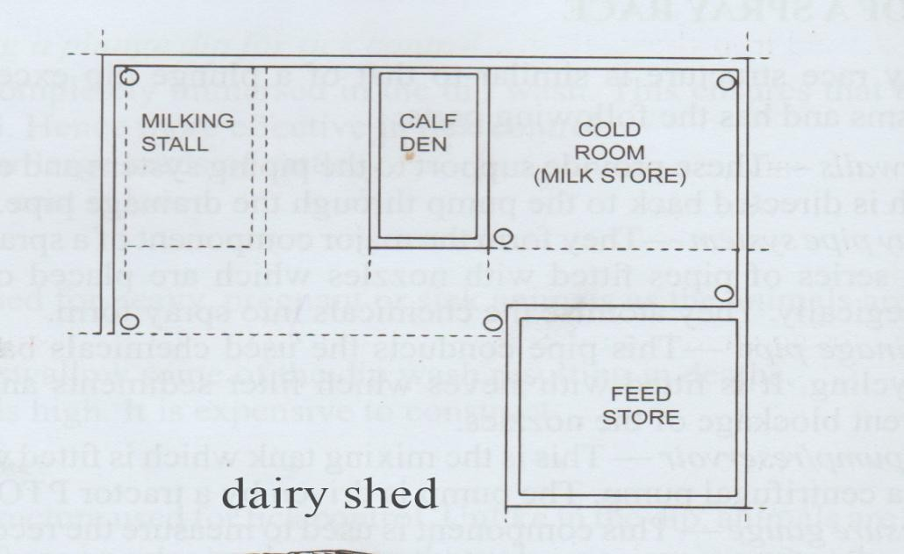
4. DAIRY SHED.
A dairy shed is a structure used for milking. It consists of the milking parlour, feed store, calf pens, equipment store and recording room. Dairy shed should have concrete floor for easy cleaning.

Slide 146
•
Parts of a dairy shed.
Milking stall-a place where animals stand and are restrained for milking.
Feed store-it is used for storing feed. Feed records are also kept here.
Calf pen- they are constructed close the milking shed to ensure that milk is given to the calves immediately after milking. They have feed and water troughs.
Milk recording room-this room is fitted with a weighing balance and a recording board. Milk is weighed and recorded in this room.
Milk store-is where milk is kept under very low temperatures to prevent it from going bad before being transported to the factory.

Slide 147
•
Maintenance of a dairy shed.
Milking shed should be cleaned thoroughly after milking.
Potholes in the concrete floors should be filled.
Broken rails should be replaced.
The cooling system should also be kept in good working conditions.
Where machines are used for milking, the system should be kept in good working conditions by servicing regularly.

Slide 148
5. ZERO GRAZING UNIT.
A zero-grazing system is a farm structure which is designed to provide sleeping, feeding and milking facilities. Cattle remain in the structure for most of the time. It has calf pen, store, feed preparation room, a milk recording room and loafing (dunging) area. They have concrete floors except for the sleeping cubicles.

Slide 149
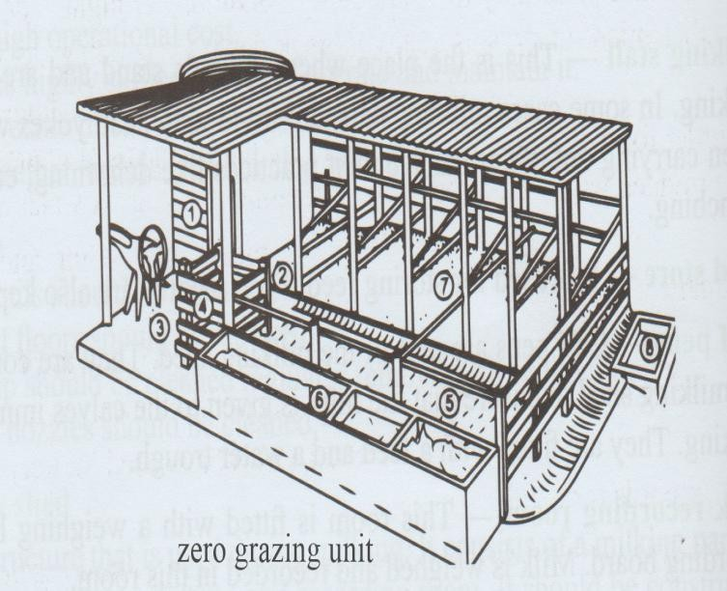

Slide 150
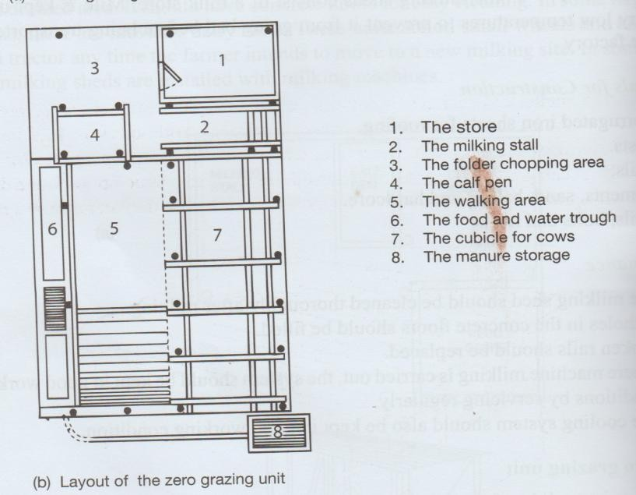

Slide 151
•
Parts of a zero grazing unit.
Milking stall-used for restraining cows during milking.
Calf pens-used for rearing calves up to 16 weeks when they are weaned.
Sleeping cubicles-used for providing shelter to the animals. May be provided with litter to make them warm.
Loafing area-it is used for resting and dunging. The loafing area is not roofed in order for animals to get sunlight for the synthesis of vitamin D. it should be provided with water troughs.

Slide 152
Feed preparation room- used for the preparation of feed rations. It may be provided with a chuff cutter for chopping fodder.
Milk recording room-used for keeping milk records for dairy cows.
Store-it is used for keeping dairy equipment such as milking bucket, milking churns, strip cup, weighing balance and dairy feeds.

Slide 153
6. CALF PEN.
This is a shelter in which a dairy calf is reared.
•
Structural requirements of a calf pen.
Should have concrete floor-for easy cleaning.
Should have Adequate space-the calf pen should be large enough to allow room for exercise, feeding and watering equipment.
Single housing- the calf pens should be constructed in a way that they allow for only one calf per pen. This prevents calves from licking each other which may lead to formation of hair balls in their rumen. It also controls the spread of worms and skin infections.
Proper lighting- calf pen should be properly lit. This
allows enough light into the pen. Light is necessary for
Vyntex technologies
_{synthesis of vitamin D}07.10250520/0743939160
153

Slide 154
Proper lighting- the area where the pen is to be constructed should be well drained. Poor drainage causes dampness in the calf pen which predisposes the calf to infections.
Leak proof roof- the roof should not leak to avoid wetness in the pen. Wetness encourages disease infections such as pneumonia, navel illness and scours.
Draught free-the calf pen should be constructed in a way that the windward side is completely solid from top to bottom to prevent cold winds from entering the pen. Cold winds predispose the calf to infections such as pneumonia.

Slide 155
Maintenance of a calf pen.
Calf pen should be kept clean.
Leaking roof should be repaired.
Walls should be white washed instead of painting to prevent lead poisoning.
It should be kept dry and warm by placing dry litter on the floor. change the litter immediately it shows signs of wetness.

Slide 156
•
•
Deep litter systems
Structural requirement for a deep litter
system.
Should be properly ventilated-done by making leeward side wall solid up to 60-90 cm from the ground and the rest of the wall is made of wire mesh.
Should have a leak-proof roof-to avoid dampness in the house which encourages diseases infection.

Slide 157
Litter on the floor-can be saw dust, wood shavings, crushed cobs, coffee and rice husks. Litter helps to keep the house warm and dry by absorbing moisture.
Draught free-achieved by marking the windward side wall top to the bottom.
Should have enough space-should allow enough space for birds to avoid overcrowding.
Proper drainage-the house should be in a well-drained place.

Slide 158
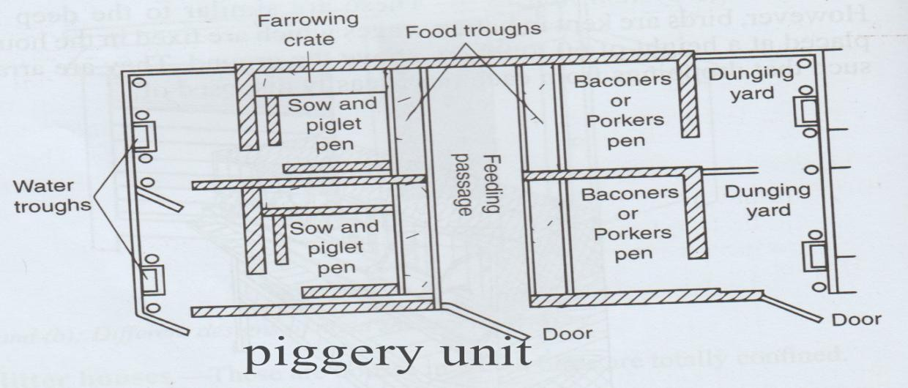
7. PIGGERY UNIT.

Slide 159
This is a structure used for housing pigs. Pigs should be provided with warm and well-ventilated house.
•
Parts of a piggery unit
Feed store-is a room for storing pig feed.
Record room-used for keeping feed and weight records.
Pig pens- pigs are kept in pens according to age and sex. Pig pens includes: -
Farrowing pen-used for farrowing and rearing piglets. It has farrowing crates which prevent the sow from lying on the piglets and eating creep feed which is meant for piglets.

Slide 160
Gilt’s pen- for rearing young females up to service age. (12 months)
Boar’s pen-are houses for breeding boars. Should be spacious to allow room for exercise and mating.
In-pig pens-a house for pregnant pigs waiting for farrowing.
Weaner’s/fattening pen-houses for piglets after weaning and up to the age of months.
Running yard-are used for dunging and basking.
Water troughs or drinking nipples-are used as watering points for the pigs.

Slide 161
Running yard-are used for dunging and basking.
Water troughs or drinking nipples-are used as watering points for the pigs.
Structural requirements of a piggery unit
Should have concrete floors for easy cleaning.
Should be free from draught as pigs easily get pneumonia.
It should have adequate space for pigs.
Should have a well-drained floor.

Slide 162
•
Maintenance of piggery.
Should be kept clean.
Should be kept dry and warm.
Holes in the floor should be filled with concrete.
Timber nails enclosing the runs should be replaced when broken.

Slide 163
8. FISH PONDS.
They are structures used for rearing fish.
•
Factors to consider when siting a fish pond
Source of water-should be near a reliable source of water.
Soil type- soil that are saturated and hold water allowing very low seepage are best for fish pond.
Topography- area should be gentle sloping to allow free flow of water.
Nature of land-
Construction

Slide 164
•
Maintenance of fish pond.
Grass should be planted to prevent soil erosion.
Weeds growing around the pond should be removed.
Proper fencing should be maintained around the pond by replacing damaged posts.
Cleaning the pond to remove foreign particles
Maintaining good level of water in the pond.
SILOS
They structure used for the preparation and storage of silage.
Examples of silos include:
-trench silo
-Tower silo
-clamp or bunker silo.

Slide 165
•
FENCES
These are structures that enclose designated areas and firm barriers for animals and humans.
•
State 9 uses of fences.
They are constructed along the boundaries to demarcate the farm land from that of neighbours.
Fences keep off wild animals and other intruders from outside the farm.
They are used to separate the crop fields from the pastures facilitating mixed farming.
They are used to divide pasture into paddocks facilitating controlled grazing systems such as rotational grazing.

Slide 166
Fences control movement of animals and people preventing formation of unnecessary paths in the farm.
Helps to control spread of parasites and diseases by keeping off wild animals from the farm.
Fences help to isolate sick animals from the rest of the herd to prevent disease spread.
Enables the farmer to control breeding by rearing different animals in different paddocks.
They provide security to the homestead and farm animals.

Slide 167
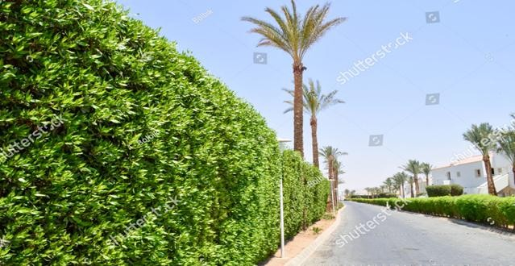
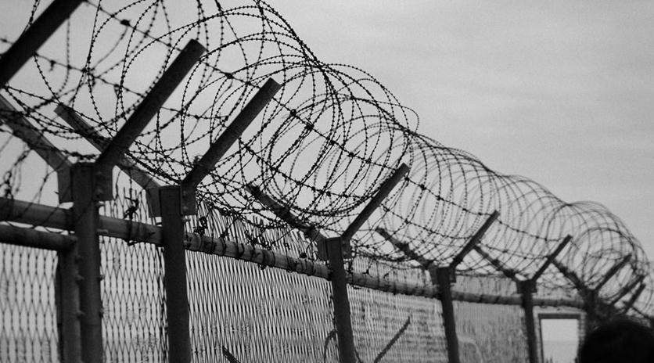
Types of fences.
•
Fences are divided into two Main categories:
•
•
Live fences.
Dead fences.
•
Live fence Dead fence

Slide 168
•
These are fences made up of growing plants such as cypress, kei apple, sisal, cacti, lantana etc.
LIVE FENCES
•
Give any advantages of live fences. (10mks)
Live fences are cheap and easy to established since can easily be raised in nurseries bed.
Tall varieties such as kei apple act as wind breaks.
Live fences have aesthetic value. (they make the environment beautiful.)
Thorny species are effective in preventing intruders.

Slide 169
Some species have medicinal effect.
Some species such as lantana camara act as livestock feed.
When trimmed, they act as a source of organic matter and wood fuel.
Their roots have hold the soil firmly hence controlling soil erosion.
Live fences provide shade for livestock.

Slide 170
•
Give any disadvantages of live fences.
They take many years to establish and make an effective fence.
They cannot be used for paddocking because they occupy a wide space.
The hedges can be hiding places for rodents and thieves.
Thorny species can cause injury to human and livestock.
They require regular trimming and infilling of gaps which is both laborious and expensive.
Their growth may be irregular hence allowing gaps for thieves and animal to pass through.

Slide 171
•
DEAD FENCES.
Different types of fences fall under this category such as plain wire, barbed wire, chicken wire and woven wire. Wire fences are used form marking the boundaries and not for paddocking.
•
Types of dead fences
Barbed wire fences.
Plain wire fences.
Woven wire fences.
Electric fences
Wooden fences
Concrete clocks, stone or brick fences.

Slide 172
•
Describe 7 steps followed when erecting/
establishing a wire fence. (7 mks)
Clear the vegetation along the fence line at least 2m wide.
Measure and mark points on the fence line where holes are to be dug determining the position of the gate. Average spacing should be 4-6 m depending on the use of the fence.
Dig holes to a depth of 60 cm for the main fence and 75 to 90 cm for the corner and gate posts.
Place treated posts in the holes in an upright position.

Slide 173
Mix concrete of 1:3:5 ratio and place it in the holes. You can alternatively put soil and stones in the hole and ram to firm the base.
Nail barbed wire onto the posts with fencing staples while stretching the wire using a wire strainer.
Fix the lower strand of wire first and use it as a guide to fix the next up to the required number.

Slide 174
Mix concrete of 1:3:5 ratio and place it in the holes. You can alternatively put soil and stones in the hole and ram to firm the base.
Nail barbed wire onto the posts with fencing staples while stretching the wire using a wire strainer.
Fix the lower strand of wire first and use it as a guide to fix the next up to the required number.

Slide 175
•
Gates and corner posts
Gates and corner posts should be slightly larger and stronger than other posts. The holes in which the posts are fitted should be made deeper about 75-90 cm. after inserting the posts in the holes, concrete should be added to reinforce the posts and rammed to make the posts firm. Alternatively, soil and stones can be used. Concrete should be allowed to dry before fixing the wire. Braces should be fixed to provide support to he posts and prevent sagging of the wire.

Slide 176
Maintenance of dead fences.
Loose or sagging wires should be straightened by use of a wire strainer.
Broken wire should be spliced(connected)
Worn out posts should be replaced.
Broken brace posts and droppers should be replaced.

Slide 177
•
GREEN HOUSES
These are structures made of glass or translucent walls and roofs. They are used for growing horticultural crops. Crops are grown in these structures under controlled environmental conditions. Green houses are constructed using: metal or wooden frames and translucent materials such as polythene sheets.

Slide 178
Maintenance of green houses.
Broken frames should be repaired or replaced.
Torn polythene materials should be replaced.
Dirty polythene sheets should be cleaned.
Crop production structures.
They include nursery bed and compost pits or heaps.

Slide 179
CH 4 AGRICULTURAL ECONOMIC II
443/1
(Land tenure and land reform)
•
What is land tenure?
Land tenure refers to the possession of rights (having the rights) to own and use land. It can also be defined as the rules or conditions governing the ownership of land in a specific area. These rights to use land usually vary hence gives rise to different tenure systems and tenure security. For example, a person who owns a title deed has more tenure security than a tenant who has just leased the land from an owner. There are many kinds of tenure systems which are mainly categorized in to two broad groups.

Slide 180
Collective land tenure system
Individual tenure system.
1. Collective land tenure system- land is owned collectively by a group of people who usually have a common binding factor e.g. clanism, co- operation etc. Collective land tenure system is further divided in to:
Communal land tenure system.
Co-operative land tenure system.

Slide 181
a. Communal land tenure system-the rights to own and use land belongs to the whole community such as a clan. Each
community member has equal rights to use the land.
•
Advantages of communal land tenure system
It allows free movement of livestock animals.
There are no and disputes because community elders solve any local problem.
The system allows land to be left for a while so as to enable regeneration of pasture.
Land cannot be easily fragmented.(divided into small pieces).
Problem of landlessness does not exist.

Slide 182
•
Disadvantages of communal land tenure
system
No one has the responsibility of taking care of the land to develop since it belongs to everybody.
Farmers have no incentive (motivation) to manage and develop land or carry out long term/permanent investments because land can be taken away anytime from them.
Because of keeping large number of livestock there is overcrowding leading to low yield in both livestock and crops.

Slide 183
There is poor stock breeding program as farmers have to incentive/motivation to improve quality of animals hence animals mix up leading to random mating and uncontrolled breeding.
Due to mixing up of animals, it is difficult to control pests and diseases.
Due to overstock that results to overgrazing, there is soil erosion that results to infertility and land denudation.

Slide 184
b.) Co-operative land tenure system-land is owned by a group of people (co-operative basis) who come together to form a co-operative society. A land title deed is issued having the name of the co-operative society.
•
Advantages of co-operative land tenure system
There are no land disputes
Labour is well utilized/used.
The larger the membership the increase in resources hence effective farm mechanization can be implemented.
Profit is distributed according to members’ shares each member has.

Slide 185
c. State ownership of land-in this system land is owned by the whole state (government land.) It controls land use, the enterprise to be raised on the farm, capital, labour and marketing. Examples include ADC farm in Kenya and ujamaa in Tanzania.
•
Advantages of State ownership of land
It raises income for the state and its citizens
May create more employment opportunities

Slide 186
1. Individual tenure system-land is owned by an individual who operates it or leaves it to to another person. This system includes the following.
Individual owner operator.
Landlord-ism and tenancy.
Company.

Slide 187
a. Individual owner operator-land is owned and operated by the farmer himself or herself.
•
Advantages of individual owner operator
Owner has incentive/ motivation to carry out long term investments in the land.
The system provides motivation in farming, conservation and improvement of land.
If the farmer has a title deed, it acts as a security to obtain agricultural loans.
Owner can either sell r give away the whole of part of the land.

Slide 188
•
Disadvantages of individual owner operator
Encourages land fragmentation (division of land into small pieces.)
If title deed is used to obtain loans and it is not repaid, land is sold.
The system encourages inequality in ownership of land hence poor resource distribution.
There are increased costs for extension services. This is because of movement to every individual farms.

Slide 189
b. Landlord-ism and tenancy-in this system, the landlord transfers the right to use land to a tenant at a fee or payment (rent) which they have agreed upon. Leasehold land tenure system-a system of landlordism, where the state gives legal right to individuals to own and use land only for a specified period of time. The government is the leaser and the individual to whom land is leased is the lessee.

Slide 190
•
Advantages of Landlordism and tenancy
Land that is idle can be put into agricultural use by the tenants hence increasing production.
Landlords (leaser) who can’t use land because of some reasons, get income after renting land to tenants.
Landless can rent land from landlords to earn a livelihood.
The system ensures equal distribution of land a s a natural resource.
The system reduces land disputes as landlord controls its allocation.

Slide 191
•
Disadvantages of Landlordism and tenancy
In case the lease period is short, tenants lack motivation to make long term investments.
If tenants have no written agreements, then they won’t have motivation on the land.
Landlords may overcharge the tenants hence loss of motivation as land rates are not controlled by the government in Kenya.

Slide 192
c. Company or concession-This is an agreement between the company and the government on the use of the land for a specified number of years. The owner of the land is usually a company or corporation. This system is also referred to as Estate or plantation because it involves large scale production of commodities such as tea, coffee, pineapples, and sugar cane.
Advantages of concession or company.
There is high efficiency in the use of land and its management.
There is creation of employment to the citizens and payment of taxes to the government.

Slide 193
Disadvantages of concession or company.
Big losses may be incurred/encountered if management is inefficient.
Companies of such kind may be engage in monopolistic practices.
•
FRAGMENTATION AND SUB-DIVISION OF LAND.
Land fragmentation-refers to a situation where a single farmer owns or has several parcels of land scattered over a
wide area.
Land subdivision-refers to the partitioning of a piece of land into a small portion.it can be due to: when selling land, sub-dividing among the children, government subdivision to settle the landless etc.

Slide 194
•
Causes of land fragmentation and subdivision
Shifting cultivation-use of land for several seasons until it is exhausted and the left fallow as the farmer moves to a more fertile land.
The traditional system-each heir is entitled to an equal share of the inheritance hence land is subdivided to the rest of the family members.
Population pressure-farmers have to buy several pieces of land due to population pressure on limited land.
Accumulation of land holdings
Traditionally offering land to settle debts.

Slide 195
•
Effects of land fragmentation and subdivision.
Wastage of time travelling from one farm to the other.
Difficult to control weeds and pests effectively as fragments are surrounded by other farmer’s holdings.
It is difficult to supervise scattered plots.
It is difficult to carry out various soil conservation measures
Difficult to offer agricultural extension advice and services.
Difficult to follow sound farm plan because of the distance between fragments and farmer’s home.
Results to poor agricultural productivity and low living standards.

Slide 196
•
LAND REFORMS
These are organized action set to improve the structure of land tenure and land uses. Land reform programs include the following.
Land tenure reform.
Land consolidation.
Land adjudication and registration.
Settlement and resettlement.

Slide 197
a.
Land tenure reform.
Are programs whose aim was to change the land tenure legislation to enhance efficient use of land.
Other important objectives of land tenure reforms include:
Encourage land conservation measures and its general improvement.
To encourage farmers to invest more through offering tenure security.

Slide 198
To achieve productivity of both land and labour.
Encourage commercial production rather than subsistence production.
Achieve utilization of national resources I.e. putting unused land into use

Slide 199
b.
Land consolidation.
Refers to bringing together fragmented pieces of land under one holding for better and effective land use. Each fragment ownership is established, measured, described and recorded. The fragments are then consolidated (put together) into one holding.

Slide 200
•
Advantages of land consolidation
There is proper supervision of land.
It saves time and transport costs as farmers work near their homes.
It is easy to provide agricultural advice by the extension officers.
There is sound farm planning and adoption of crop rotation programme.

Slide 201
It facilitates carrying out of soil conservation measures and land improvement as well as farm mechanisation.
Facilitates construction of permanent structures such as fencing and building.
Weeds, pests and diseases can be easily controlled.

Slide 202
c.
Land adjudication and registration
Land adjudication involves:-
Establishment of ownership
Measurement
Description
Recording of land.
This process is carried out by the government to facilitate legal ownership of land and to reduce land disputes among citizens.at the end a land certificate/title deed is issued to each farmer whose land has been adjudicated as an evidence of legal ownership of the land.

Slide 203
•
Details/Information contained on land title
deed.
The size of land
Name and identity number of the owner
The number of the title/ land parcel number or location.
The date of registration.
Seal and signature of the issuing officer.
Condition of the land, if any.
The type of ownership

Slide 204
•
Advantages of a land title deed/land
registration certificate.
It can be used to secure credit facilities such as loans.
Land disputes are minimised.
Possession of title deed encourages farmers to invest in long term and permanent projects on their land and also care for the land.
Enables the occupant to lease all or part of the land hence gets income.

Slide 205
d.
Settlement and Resettlement.
Settlement -refers to occupation of land which was previously uninhabited.(not occupied at all.)
Resettlement -refers to the process of transferring people from densely populated areas to sparsely populated areas, i.e. the million acre scheme.

Slide 206
•
What are the objectives of Land
redistribution?
To ease the population pressure by transferring people to sparsely populated areas/uninhabited areas.
To increase agricultural production-through putting idle land into use.
To create employment-helps in production of food crops and livestock.
To form tsetse-fly consolidated barrier.

Slide 207
•
•
Development of settlement schemes in Kenya
The million acre scheme
Its aim was to transfer about 1,000,000 acres of land in the ‘white highlands’ to Africans during independence.it was divided into high density schemes (land was fertile and productive), low density schemes(land was relatively poor with low population.

Slide 208
•
GENERAL OBJECTIVES OF THE MILLION
ACRE SCHEME.
To transfer land from whites settlers to Africans.
To reduce population pressure in African reserves.
to settle former employees of europeen farmers and squatters.
To solve unemployment problem.
To increase agricultural production.
Maintain production levels achieved by former white settlers and also earn foreign exchange.

Slide 209
Examples of settlement schemes under the million acre scheme.
Ol kalou salient scheme
Harambee settlement schemes
‘Z’ plots
Other settlement schemes started by the government following the million acre scheme
Jet schemes
Haraka schemes
Shirika schemes
Lari settlement schemes
The squatter’s settlement schemes

Slide 210
•
What were the requirements for success of
settlement schemes?
There should be high population pressure in the reserves.
There should be enough economic motivation to persevere.
Settlers should have enough capital.
Settlers should come from far to break from traditional society and stay on the scheme.

Slide 211
Ch5 SOIL AND WATER CONSERVATION 443/1
Soil erosion
Refers to process by which soil is detached, removed and carried away from one place to another where it may not be useful.

Slide 212
State and explain 10 factors that influence soil erosion. (10 mks)
Slope of the land/topography-speed of water is determined by the slope. Water flows with high speed on steep slopes hence it has high erosive power which increases erosion. The steeper the slope, the greater the speed of water the higher the erosive power and the higher the erosion.
Vegetation cover-vegetation cover such as forests protects the soil against erosion, trees act as barriers preventing exposure of soil to agents of erosion.

Slide 213
Overstocking-it leads to uncontrolled grazing (overgrazing) which leaves the land bare exposing it to soil erosion agents. Animal trampling also has erosive effect on the soil.
Deforestation-this is indiscriminate removal of trees from forested areas. Clearing forests leaves the soil exposed both to high temperatures and heavy rainfall hence organic matter is washed away by the surface run off.

Slide 214
Amount and intensity of the rainfall- raindrops hit the ground with force that splashes soil particles which are then carried away by flowing surface run-off in areas with heavy rains.
The type of soil-soils which are coarse textured
I.e. sand soil easily become saturated with water hence they are easily eroded compared to soils with fine textures which have are not easily saturated with water and are not easily eroded.

Slide 215
Soil depth-soils with shallow depth are easily saturated hence eroded easily compared to deep soils.
Burning of vegetation-soil is left exposed or unprotected against agents of soil erosion.
Clean weeding-leaves the soil more or less unprotected against water erosion as most vegetation (weeds) is cleared leaving some areas exposed.

Slide 216
Planting annual crops on steep slopes-leads to frequent cultivation which exposes the soil to erosion.
Ploughing up and down the slope.-creates channels along the slope that run from up and down which makes it easy for water to flow down the slope with high speed and erosive power.

Slide 217
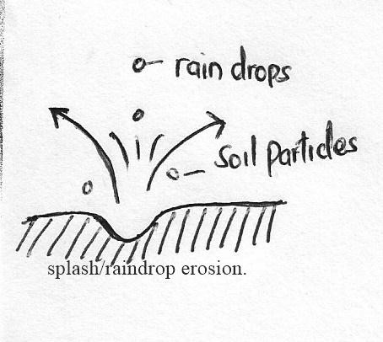
Types of soil erosion
Splash erosion-results from the impact(effect) of water droplets from rain that fall on soil particles or on thin water surfaces.

Slide 218
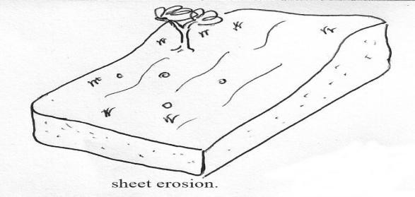
Sheet erosion-is the removal of soil in thin layers from flat or gently sloping land uniformly. Caused by surface flow of water which detaches and transports the soil.

Slide 219
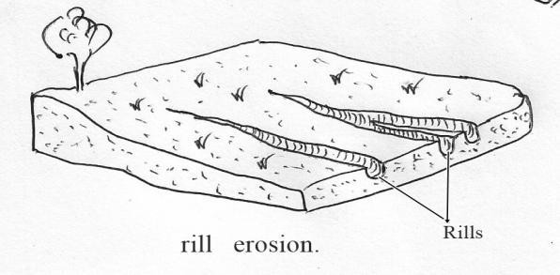
Rill erosion-is the removal of soil by water from small well defined channels (rills) that flows down the slope.

Slide 220
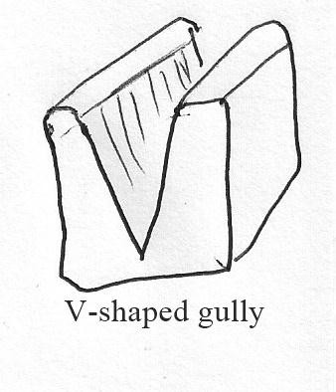
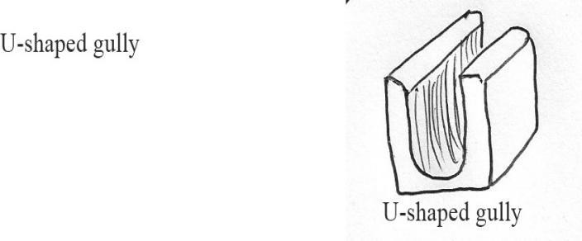
Gully erosion-is the advanced stage of rill erosion where the rills progressively become deeper and wider until they form gullies. Gullies can either be V-shaped or U-shaped.

Slide 221
Wind erosion-removal and carrying away of soil by wing.
Soil erosion through human activities-activities such as overstocking leading to overgrazing which expose soil. Other human activities that contribute to soil erosion include mining, road and building construction and quarrying.

Slide 222
Effects of soil erosion
Erodes or carries away productive top soil
Carries away soil micro-organism such as decomposers
Deposits eroded materials in dams, rivers hence they become shallow creating silting problem.
Causes sedimentation and silting in lakes, rivers and fish ponds. This leads to reduction in fish production.
Excess surface run-off causes damage by exposing underground pipes and destroys roads.

Slide 223
RIVERBANK EROSION
Is the erosion that occurs along the riverbanks due to:
large water volumes
Speed of water and
Amount of materials carried in the water.

Slide 224
Effects of riverbank erosion
Widens riverbed through eroding the bank and reducing land for cultivation.
Causes sedimentation in dams and other water bodies due to materials carried in water.
Materials carried damage the banks.

Slide 225
How to control riverbank erosion
Planting trees along the riverbanks. They hold soil particles together and reduce erosion.
Construct dams to control water flow.
Construct dykes to control flooding
Observe government rule on leaving a strip of uncultivated land along the riverbank.

Slide 226
MASS WASTING/ SOLIFLUCTION EROSION.
Mass wasting-refers to the flow of surface materials saturated with water due to gravity. The earth materials flows from steep slopes as a result of heavy rains .

Slide 227
•
Solifluction or mass wasting is influenced by
the following factors:
Slope of land/topography-there is faster movement of materials on steep slopes compared to gentle slopes.
Climate-there is movement of materials in areas with heavy rains periods as the materials become wet and can easily be moved by gravity.
Vegetation cover-mass movement occurs easily and faster when the land is bare without vegetation than when land is covered with vegetation.

Slide 228
Human activities-activities such as mining, deforestation, quarrying and cultivation interfere with stability of materials which initiates mass wasting.
Nature of materials- in cases where massive rocks overlie week sedimentary rocks that have clay, mass wasting can easily take place. If the materials contains more water then they are susceptible to movement.
Forces with the earth’s crust-forces such as earth tremors, earthquakes and volcanic eruptions causes large movement of materials due to
gravity.

Slide 229
Landslides.
Refers to the movement of rock debris(rock fragments or remains) down a slope or mountain side.it can also be described as sudden rotational movement of mass of soil or rock along a slope.in landslides the materials have less water compared to in Solifluction.

Slide 230
Types of land slides.
Slump/slip- movement of rock masses for a short distance.
Debris slide-materials move at a great speed resulting to loss of lives.
Debris fall-movement of materials is along vertical position or overhanging cliff.
Rock fall-occurs in very steep slopes and nearly in a vertical position where blocks move down a steep cliff .
Rock slides-masses of rock materials slide down a bedding plane, a joint or a fault face.

Slide 231
Effects of mass wasting. (6mks)
Decline in soil fertility as fertile materials are deposited elsewhere.
Creation of lakes.
Damages property and cause loss of life.
Causes soil erosion in steep slopes.
Leaves permanent scars on landscape
Tourist attraction centre such as rock fall I.e. crying stone of kakamega and kit mikai in seme, kisumu county.

Slide 232
Describe the methods/measures used in soil and water conservation.
Soil conservation measures are classified into:
Biological or Cultural control measures- includes farming activities that help to minimize erosion
Physical or structural measures-involves mechanical construction of some structures that help to control erosion.

Slide 233
State and explain how Biological or Cultural control measures help to conserve soil and water.(9mks)
use of grass strips/filter strips: are uncultivated grass strips along contours between cultivated strips. They reduce speed of flowing water. They filter out soil particles from the moving water .Disadvantages of strips-They can increase pest infestation to crops and they also limit use of machines.
Cover cropping-involves establishment of a crop that spreads over the surface of the soil to provide it with a cover. The cover crop controls erosion by preventing movement of soil particles and it also prevents impact of rain drops that causes splash erosion. Cover crops also preserve soil moisture and prevent volatilisation of nutrients. Best crops for cover cropping include sweet potatoes, beans, lucerne, desmodium, grasses etc.

Slide 234
Contour farming-all operations such as tillage and planting are done along the contour/across the hill to create ridges which holds up water and prevent rill erosion by reducing run-off.
Mulching-refers to covering of the soil with either organic or inorganic materials such as grass and crop residues or inorganic materials such as polythene sheets. Mulching conserves soil and water in the following ways:
-prevents splash erosion
-reduce the speed of run-off hence reducing erosion and increasing infiltration.
-increases organic matter when the mulch decomposes and also enhances water retention capacity.
-Reduces evaporation hence conserving soil moisture.

Slide 235
Use of cropping systems-rotational grazing can be used to allow grass to regenerate after a certain period of time. Crop rotation helps to build up organic matter and improve soil structure. Use of manure and fertiliser, intercropping, timely planting and correct spacing also conserves soil.
Strip cropping-poor soil cover crops can be alternated with strips that have good cover to control movement of soil particles and control erosion.
Grassed or vegetated waterways-grass and other vegetation can be planted or allowed to grow in water channels and depressions. This helps to reduce speed of run-off water and traps soil particles preventing erosion.

Slide 236
viii.Afforestation/Reaforestation-afforestation refers to planting trees where tress had never existed while Reaforestation means planting of tress where forests have been cleared.
Roles of tress in soil and water conservation
-they protect the soil from raindrop erosion by reducing the force with which it fall on the ground.
-trees provide shade hence reducing loss of moisture through evaporation.
-trees act as windbreaks preventing wind erosion.

Slide 237
-roots of trees binds the soil particles together.
-trees also reduce speed of running water thus reducing its erosive power which reduces soil erosion.
-tree leaves decay/decompose to supply humus to the soil which improves soil fertility and water infiltration.
ix.Agroforestry-refers to the growing of crops, trees and rearing of animals on the same piece of land. The planting of trees and shrubs helps to conserve soil and water as described in the roles of trees above.

Slide 238
State and explain how physical or structural control measures help to conserve soil and water.(5mks)
Trashlines/stone line- trash lines are made up of crop residues (remains) such as maize stalks, grass etc. They help to trap soil when being washed away.
Bunds- these are heaps of soil along the contour. Grass may be planted on top of the bunds to hold them together. They facilitate better erosion control.

Slide 239
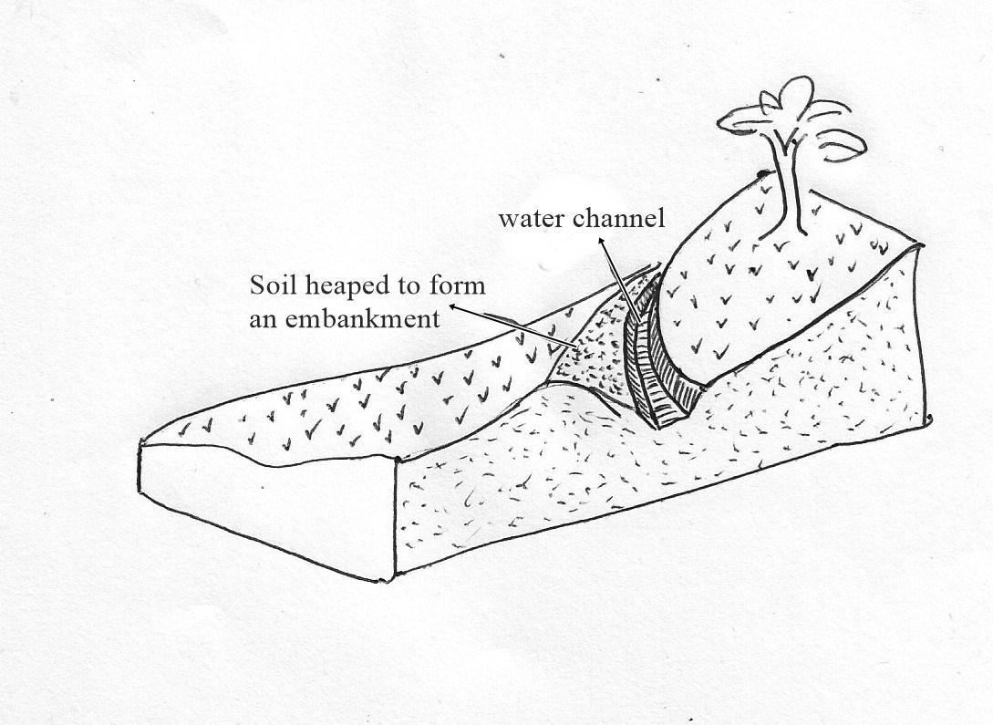
c) Cut-off drains-an open trench with an embankment (soil heap) on the lower side.it collects and diverts water from cultivated slopes and discharges it to the river valley or to the ground where erosion cannot take place. A cut-off drain discharges water in a natural waterway, a non erodable land like a rock and into an artificial waterway.

Slide 240
d). Terraces-constructed to reduce the surface flow of water and to carry any excess water that cannot be absorbed by soil.
Types of terraces
-Broad-based terraces-are wide at the base.
-Narrow-based terraces-are usually level and shorter
-Bench terraces-are constructed on steeper slopes.
-’’Fanya juu’’ terraces-a ridge is dug and the soil is heaped up hill.
-Gabions/porous dams-constructed using wire mesh filled with stones across a slope or gullies. They trap soil as water flows through the stones slowly.

Slide 241
e) Dams and reservoirs-A dam is a wall or a barrier constructed a cross a river to hold and store water. It reduces the speed of water. A reservoir can be a small or big tank that is used to hold excess water from roof tops.
A check dam- can be constructed across a channel to reduce the speed of water and still allow soil particles in the water to settle.it is made of debris, concrete or stone

Slide 242
Water harvesting Methods used
Uses of weirs-weirs are barriers constructed across a river to raise the water level and still allow the water to flow over it.
Use of dams-they collects and holds large volume of water. They raise water level to form reservoir for storing water.
Ponds
Roof catchments-catchment and storage of rain water.
Use of wells
Rock catchment-harvesting rain water from big rocks.

Slide 243
Micro-catchments
Are micro-environments designed to conserve soil and water around growing crops such as bananas or citrus tree crops.

Slide 244
CH6 WEEDS & WEED CONTROL 443/1
What is a weed?
A weed is any plant that grows where it is not requires and whose economic disadvantages are more than the advantages. Crops that volunteer to grow with having been planted are call self- setters. Weeds that are dangerous and whose cultivation has been prohibited by the law are called noxious weeds.

Slide 245
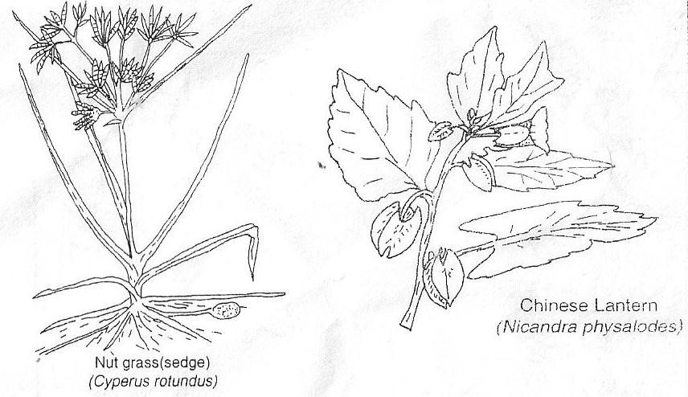
Weeds identification and classification

Slide 246
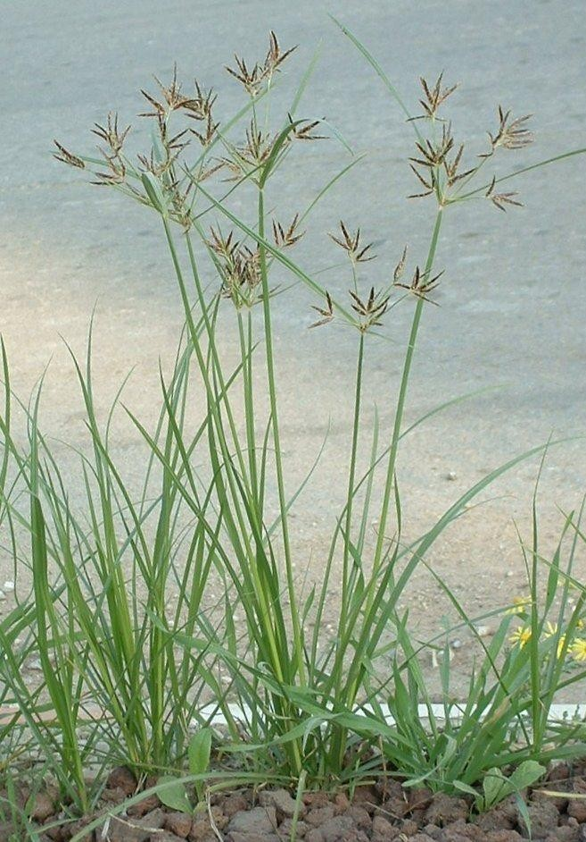
Nut grass

Slide 247
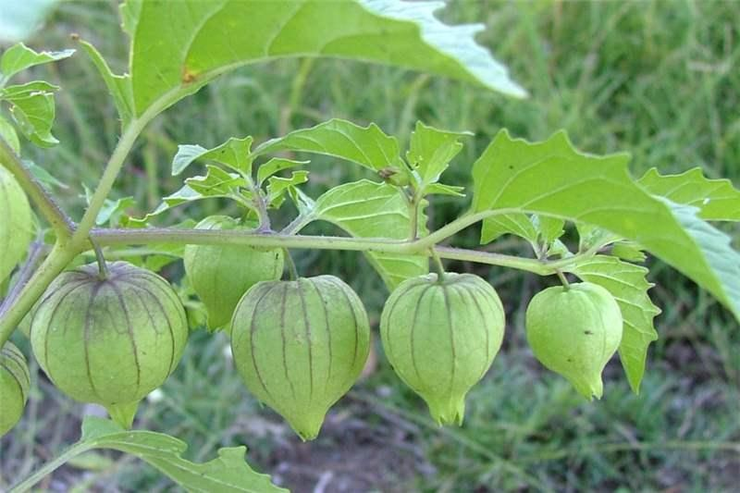
Chinese lantern

Slide 248
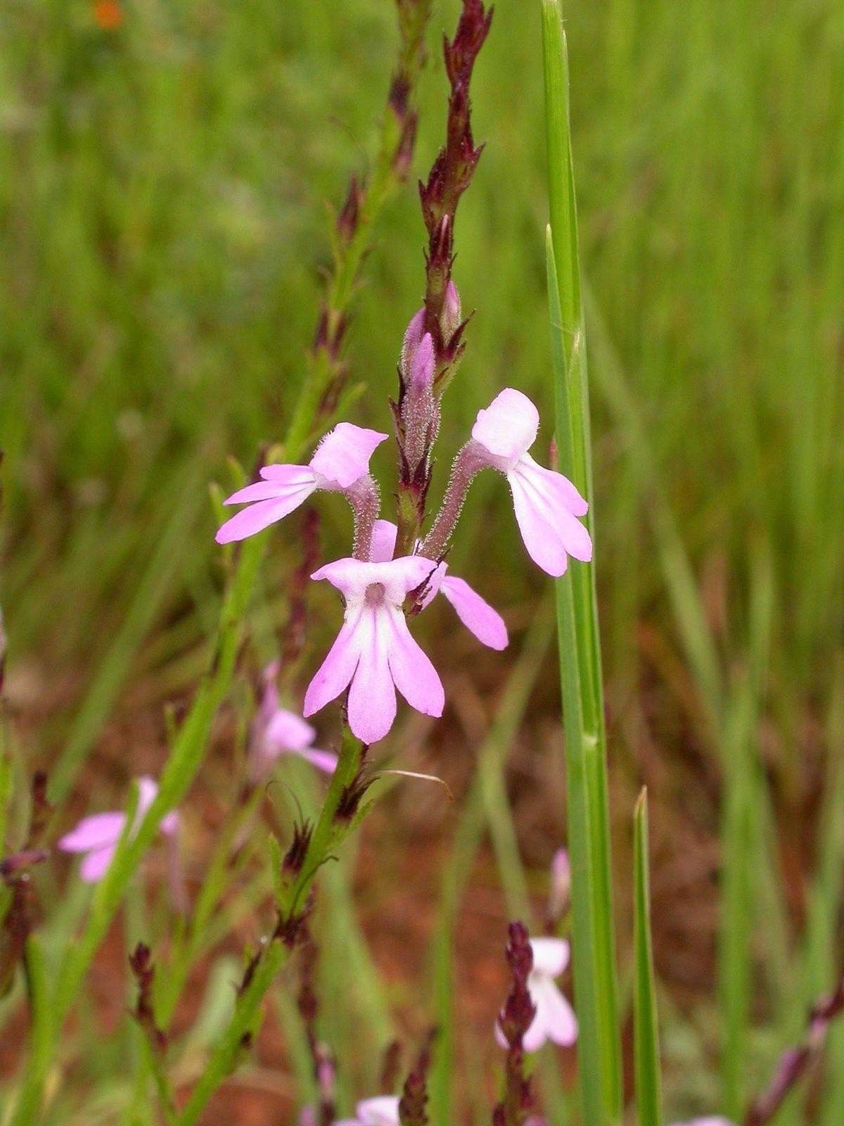
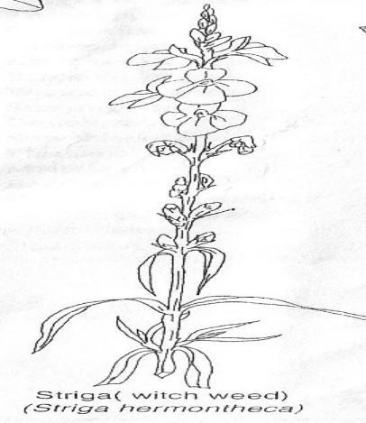
Striga weed

Slide 249
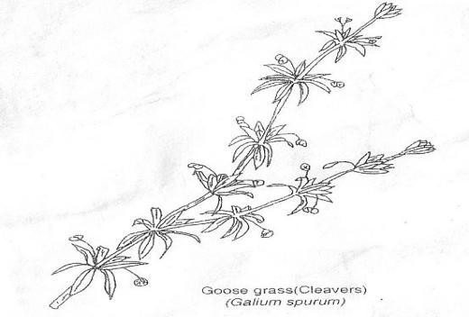
Goose grass

Slide 250
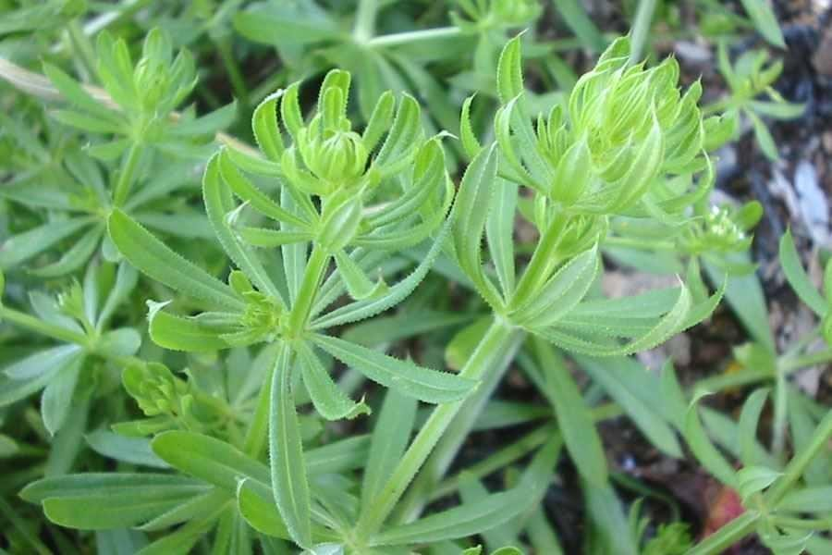

Slide 251
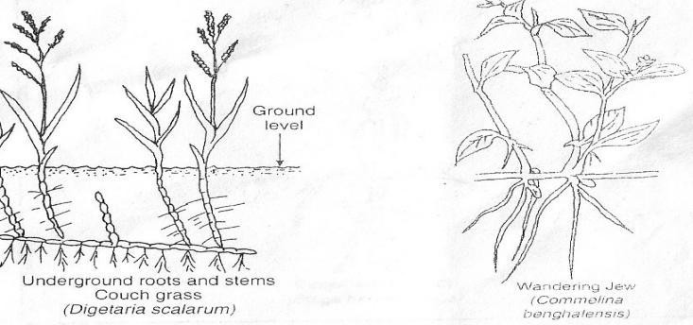

Slide 252
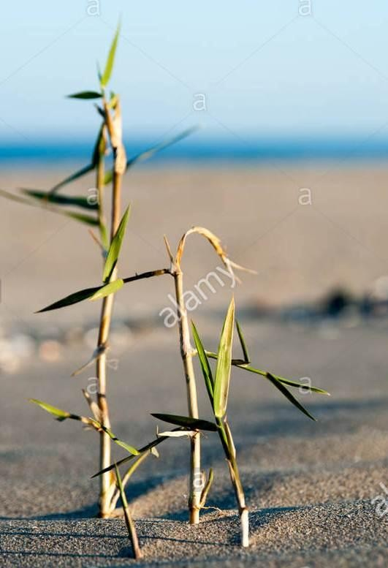
Couch grass

Slide 253
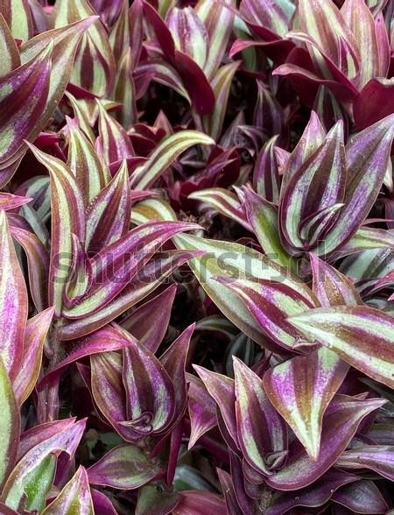
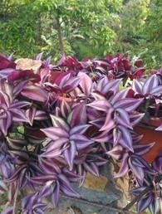
Wandering jew

Slide 254
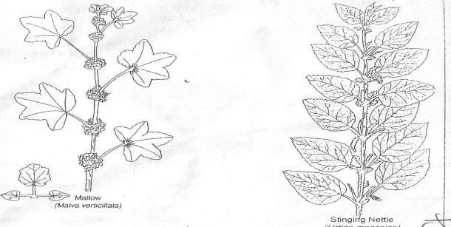

Slide 255
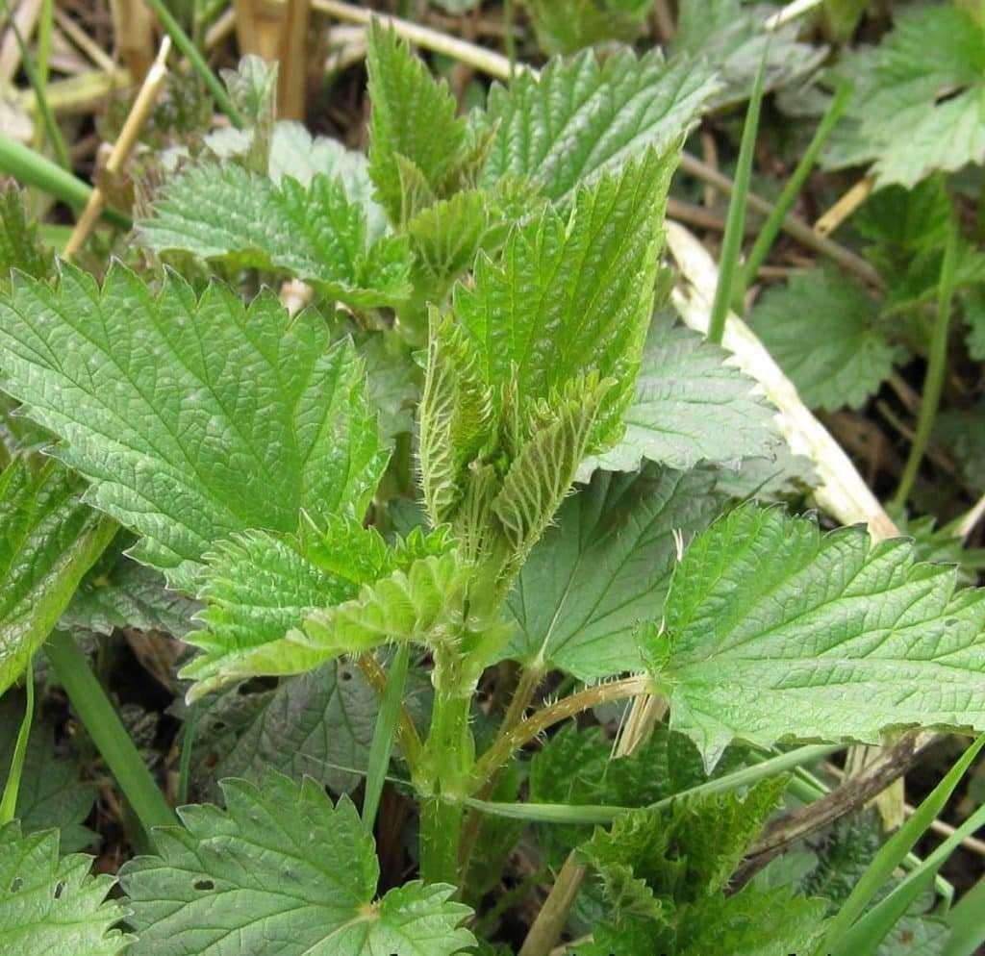
Stinging neetle

Slide 256
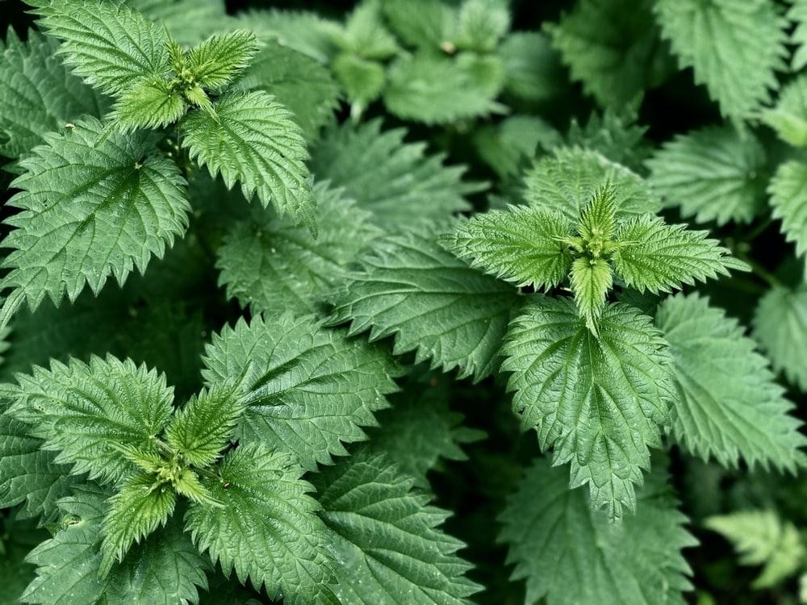
Stinging neetle

Slide 257
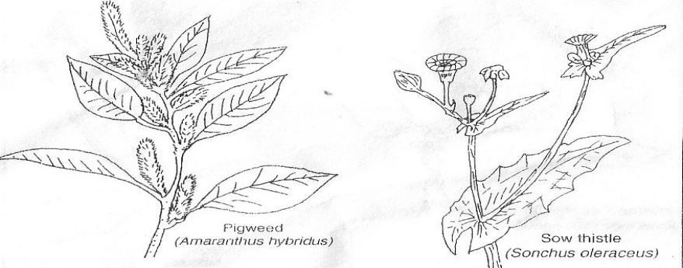

Slide 258
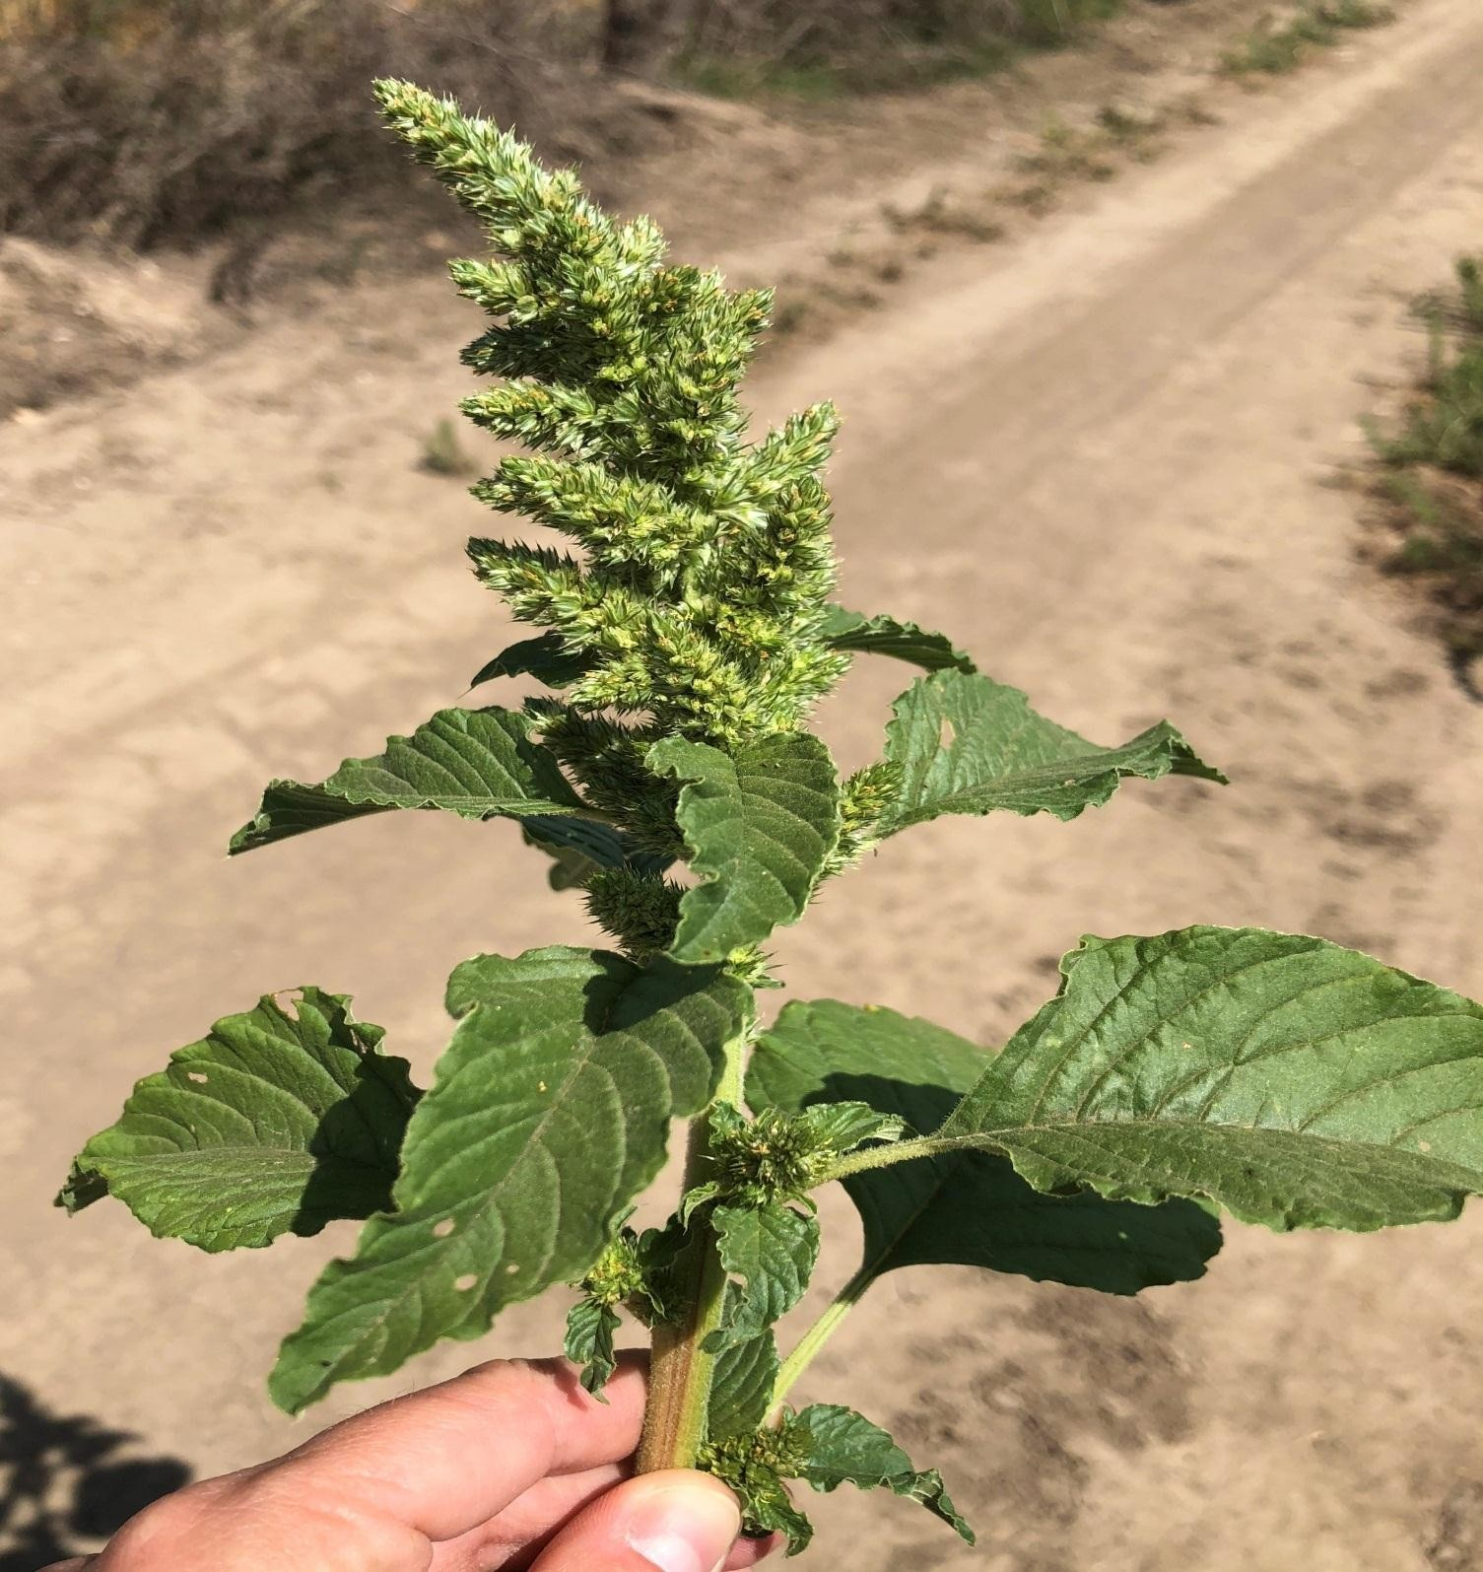
pigweed

Slide 259
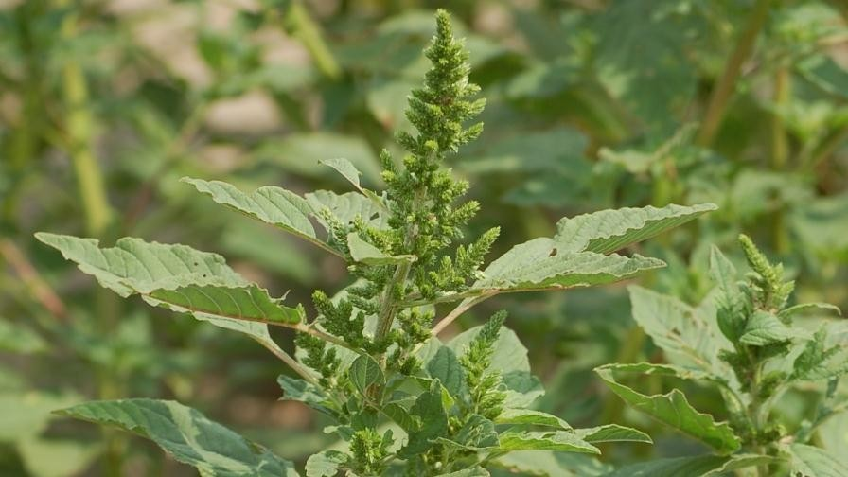

Slide 260
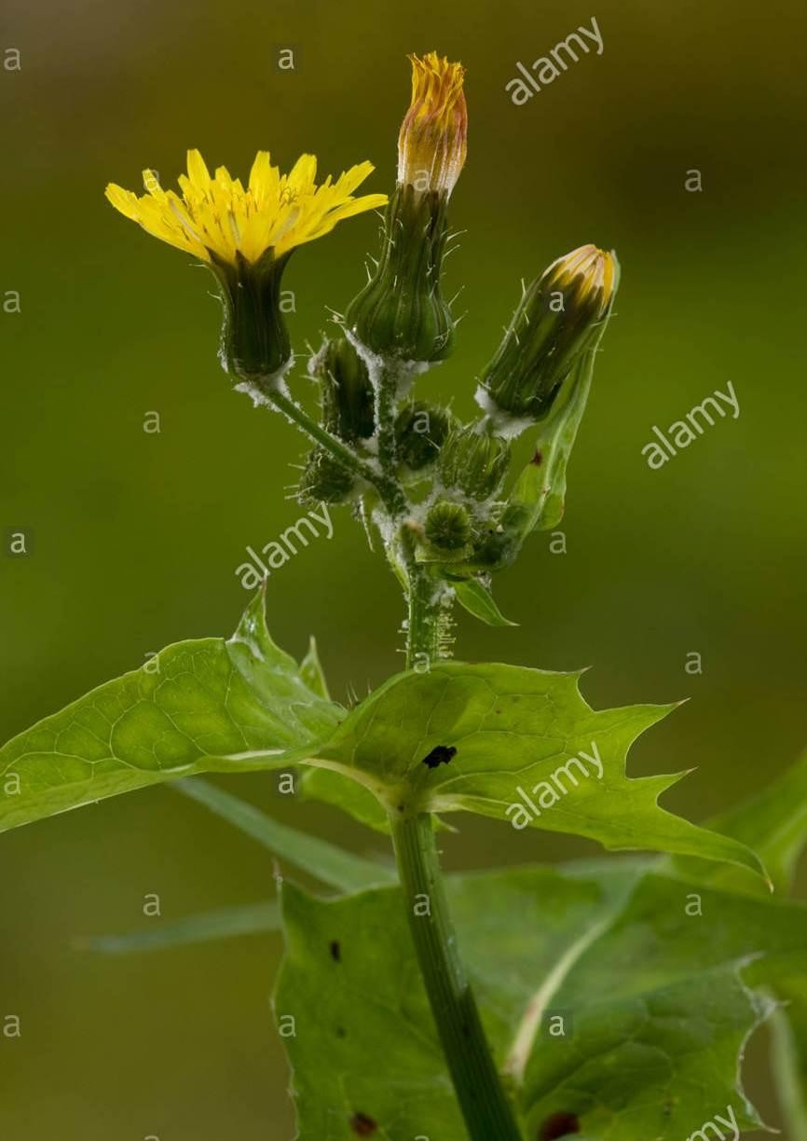
Sow
thistle

Slide 261
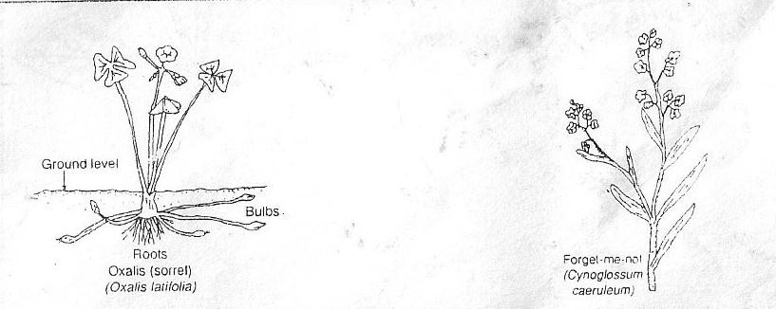

Slide 262
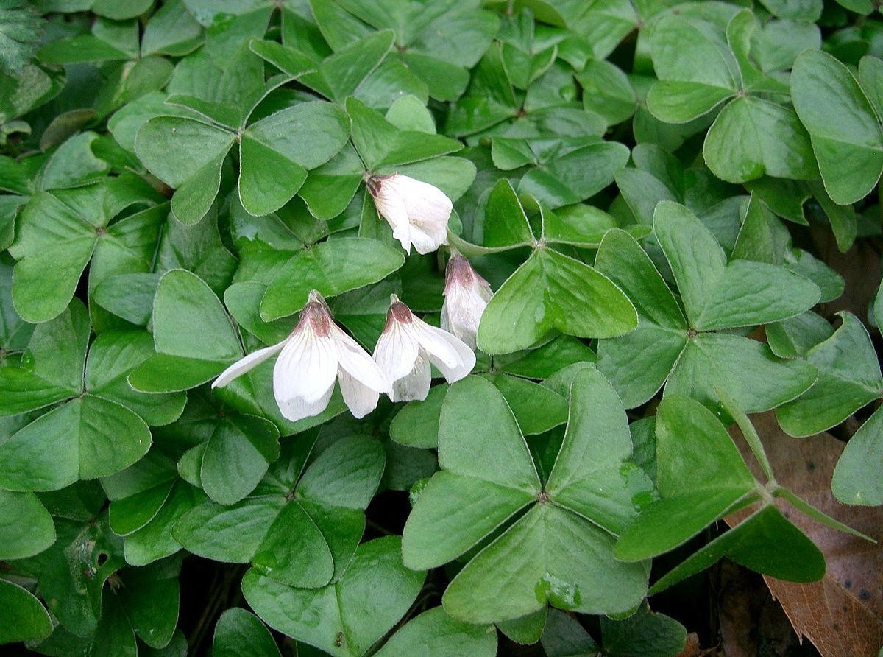
oxalis

Slide 263
Forget-me-not

Slide 265
lantana

Slide 266
Macdonalds eye

Slide 268
Double thorn

Slide 271
Black jack

Slide 272
Soddom apple

Slide 273
Classification of weeds.
Weeds are classified based on:
Growth cycle.
Plant morphology.

Slide 274
According to growth cycle:
Weeds are classified as annual, biennial and perennial weeds.
Annual weed-they complete their life cycle in the field in a period of one year. They include Mexican marigold, black jack, pigweed etc.
Biennial weeds-they complete their life cycle in two years. They include American wild carrot, spear thistle, ragwort.
Perennial weeds-they take more than two years to complete their life cycle. They include sedges, lantana, Kikuyu grass, wandering Jew, couch grass, Sodom apple etc.

Slide 275
According to plant morphology:
Weeds are classified as narrow-leaved and broad- leaved weeds.
Narrow-leaved weeds-are mostly grasses such as couch grass, spear grass, setaria, eleusine etc.
Broad-leaved weeds-includes black jack, oxalis, lantana, pigweed, devil’s horse whip etc.

Slide 276
Competitive ability of weeds
What factors contributes to the competitive ability of weeds.
Weeds have ability to produce large quantities of seeds e.g. pigweed.
Weeds seeds remain viable in the soil for a long time waiting for conducive conditions for germination.
Most weed seeds are successfully dispersed

Slide 277
Some weeds have the ability to propagate vegetative e.g. couch grass and wandering Jew.
Some weeds have elaborate root system that supports the plant in nutrient absorption and water uptake.
Weeds have ability to survive in areas with limited nutrient supply.
Some have short life cycle.

Slide 278
Give 10 ways in which weeds are harmful to agriculture. (10mks)
Weeds compete with crops for nutrients, space, moisture and sunlight hence they reduce yields.
Some weeds are parasitic to cultivated crops e.g. such as witch weed to maize.
Some weeds lower the quality of agricultural produce when they are mixed up with the produce, for example, Mexican marigold produce unfavorable flavour in milk if it is fed on by dairy animals while devil’s horse whip, black jack and forget-me-not get attached to sheep wool lowering its quality.

Slide 279
Some weeds are poisonous to man and livestock e.g. thorn apple, Sodom apple.
Some weed acts as alternate hosts for insect pests and for other diseases e.g. wild oats are alternate host for rusts.
Some weeds are allelopathic, that is, they can produce poisonous substances which may suppress growth of cultivated crops.

Slide 280
Some weeds are difficult to handle and control because they irritate the workers e.g. double
thorn, stinging nettle and devil’s horse whip.
Weeds lower the quality of pastures by reducing palatability e.g. tick berry(lantana)
Aquatic weeds such as silvinia and water hyacinth affect fishing because they block navigation and deprive fish of oxygen.
Some weeds block irrigation channels making it difficult for water to flow freely in the irrigated land.

Slide 281
Mention any 5 ways in which weeds are beneficial to farmers (5mks)
Some weeds are edible to man and livestock e.g. pigweeds, wandering jew and grass weeds.
Some weeds have medicinal effects; they provide herbal medicine to both livestock and human beings e.g. Sodom apple.
Weeds acts as soil covers preventing raindrop erosion.
Weeds add organic matter to the soil when they decompose hence improving fertility.
Leguminous weeds are able to fix nitrogen in the soil.

Slide 282
Weeds control methods
Weeds control methods are grouped in to five main categories:
-legislative weed control methods
-mechanical weed control methods
-biological weed control methods
-Cultural weeds control methods
-chemical weeds control method
•

Slide 283
1. legislative weed control methods
This method involves government laws and acts which prevents introduction of noxious weeds in a country or prevents the spreading of foreign weeds from one part of the country to another.
2. Mechanical weeds control
This method involves operations such as tillage, slashing and uprooting.
Tillage- aims at desiccating (drying) weeds by exposing them or burying them hence killing them. Done by use of either hand tools or tractor drawn implements.

Slide 284
Advantages of tillage
It is cheap
Opens up land allowing water infiltration.
During tillage, earthing up can also is done to encourage root growth.
During tillage, crop residues (remains) can be incorporated into the soil.

Slide 285
Disadvantages of tillage
Tillage creates suitable conditions for weeds growth.
If tillage is done excessively, it pulverizes the soil destroying soil structure.
Incase of large piece of land, tillage is laborious and expensive.
Excess cultivation leads to water loss, soil erosion and damage to crops.
These methods may not effectively control weeds.

Slide 286
Slashing-involves removal of shoots from weeds especially in annual weeds.
Uprooting-it is done where weeds are scattered and the crops are too close to allow for mechanical cultivation
3. Biological weeds control method
In this method, living organisms are used to control weeds for example
-Livestock used to graze weeds coconut and cashew nuts plantations
-use of certain weed eating fish to control aquatic weeds.

Slide 287
4. Cultural weeds control methods. (8mks)
These are farming practices that help to control weeds when they are practised. Cultural weeds control methods include:
Mulching-mulch smothers weeds preventing their growth.
Cover cropping-also smothers weeds preventing them from growing.
Crop rotation-it helps to escape those weeds that are only associated with certain crops for example striga grows in association with cereals.

Slide 288
Timely planting-allows crops to be established early before the weeds, hence smothering them.
Proper spacing-helps to create little space for weed growth and forming canopy which suppresses weeds.
Flooding-practiced in rice fields, it discourages the growth of all non-aquatics weeds.
Use of clean seed/planting materials-it prevents introduction of weeds to the farm. Clean planting materials are pure without any weed contamination.
Clean seedbed-a clean seed bed ensures seeds starts off/germinates effectively to compete weeds. Done by harrowing or spraying herbicides in ploughed seedbed before planting.

Slide 289
5. Chemical weed control method.
This method uses chemicals to control weeds. Chemicals used to control weeds are called herbicides.
Ways in which herbicides kill weeds(5mks)
They inhibit nitrogen metabolism.
They kill cells in weeds.
They cause abnormal tissue development in weeds.
They inhibit photosynthesis.
They inhibit respiration process.

Slide 290
Classification of herbicides
Herbicides are classified according to:
Formulation-physical form in which herbicides exists. They can be inform of liquid(soluble in either water or oils) , wettable powders(finely grounded particles).
Times of application-herbicides are effective when applied at different stages of weed growth. They are classified as pre-emergency herbicides-are those herbicides applied soon after crop seeds have been sown(planted) but before they emerge(germinate). Post-emergency herbicides-are those which are applied after crop germination or transplanting.

Slide 291
Selectivity-herbicides are classified as selective or non-selective. Selective herbicides-it targets and injures one type of plant (weed) and allows the crops planted to grow. Non-selective herbicides-kills all the crops in the field.do not select plants to kill.
Mode of action-herbicides can be contact or translocated. Contact herbicides-are those that kill only the part of the plant they come in contact with. Translocated or systematic herbicides-are herbicides that kill the whole plant even if it comes in contact with only a small part of the plant.

Slide 292
Give the safety precautions observed when using chemicals.
Always read manufacturer’s instructions first and follow them.
The user should always wear protective clothing such as overalls, breathing masks, gloves and boots.
Avoid inhaling the herbicides.do not spray against the wind.
The user must bath thoroughly after handling chemicals.
The user must not blow or suck blocked nozzles.

Slide 293
Precautions to be observed to prevent danger to other people and environment.
User must avoid spraying to unintended crops
Spraying to animal feeds and water should be avoided.
User must avoid spilling herbicides in places which are unintended and where they cause danger to animals.
Any leftovers and empty containers must be properly disposed off I.e through burying.

Slide 294
Spraying equipment must not be washed in water sources used by animals and humans.
All chemicals must be stored in safe places out of reach of children and away from food.
Equipment used for spraying herbicides must be thoroughly washed.

Slide 295
Outline the advantages of using herbicides. (Chemical weed control)
It requires less labour than mechanical cultivation.
Herbicides can be used to control bothersome weeds such as couch grass and sedges.
Use of herbicides does not disturb crops roots and other underground structures.
Herbicides application is efficient in both wet and dry soil conditions which would not be easy for mechanical cultivation.

Slide 296
Soil structure is maintained as soil is not disturbed.
More convenient to use in crops such as sisal and sugar- cane.
It is cheaper in the long run than the use of manual or mechanical cultivation.
Disadvantages of using herbicides. (chemical weed control)
Requires skilled labour in mixing the chemicals and application.
There are risks to the environment and the user.
Some herbicides have long residual effect which might interfere with future crops.

Slide 297
Ch7 CROP PESTS AND DISEASES
paper 1
Pest and diseases cause a lot of damage to crops both in the field and in the stores.
A crop pest refers to a living organism that destroys crops either directly by causing physical damage to the crops or indirectly by introducing disease causing organisms (pathogens) into the plant.
Example of pests include insects, rodents, nematodes, mites and large animals such monkeys, elephants and buffaloes.

Slide 298
•
Harmful effects of crop pests
Pest such as squirrels and mice unearth planted seeds resulting in low plant population.
Some pests such as nematodes, termites and moles damage crop roots causing wilting and death to the plants.
Pests deprive the plants its food by sucking plant sap resulting in retarded growth.
Pests destroy crop leaves lowering the photosynthetic area resulting in reduced yields.

Slide 299
Sucking pests attack fruits, berries, flower hence lowering their quality and quantity.
Some pests destroy the embryo of seeds, thus lowering their germination potential.
Some pests transmit crop diseases while others open plant to secondary infection.
Pests reduce marketability of crop produce by lowering quality.

Slide 300
•
Pests are classified according:
Classification of Pests.
a)Mode of feeding.
The mode of feeding of pests is determined by the nature of their mouth parts. There are those with biting and chewing mouth parts while others have piercing and sucking mouth parts.
b) Crops attacked.
Pests are crop specific. They prefer certain crops for example coffee pests.
c) Stage of development of the pest.
Some pests are harmful when they are in larval stage or nymphal stage while others affect crops during their adult stage.

Slide 301
d) Stage of the crop attacked.
Some pests attack crops when crops are still young and tenders while other pests attack when crops are flowering or mature.
e) Scientific classification.
Pests may be classified according to scientific grouping for example, insects, birds, nematodes, mites and others.
f) Level of damage.
Pests that cause less damage are called minor pests while those that cause great damage to particular crops are called major pests.

Slide 302
a)The place where pests are found.
According to where they are found some pests cause damage to crops while in the field. They are therefore called field pests. Others cause damage to stored produce. They are called storage pests.
•
Field pests
Identification of Pests.
a)Insects pests.
Insect pests are classified into those with biting and chewing mouth parts and those with piercing and sucking mouth parts.

Slide 303
Insects with biting and chewing mouth parts.
They are the most serious. They include: locusts, grasshoppers, crickets, maize stalk borers, army worms, cutworms, bollworms, termites etc.
They cause damage to;
Leaves-damage leaves reducing photosynthetic area of the plant such as kales.
Stems- damage stems interfering with transport system within the plant which reduces yields.
Roots- damage roots and tubers affecting nutrient and water uptake. This may lead to wilting and death of the plant.
Flowers and fruits-damage on flowers and roots make them to fall hence reducing crop yields. Also lowers quality of fruits that do not fall.

Slide 304
Insects with piercing and sucking mouth parts.
They include aphids, scales, certain fleas, cotton seed bugs, cotton leaf hoppers, mealy bugs and thrips.
They suck out plant sap resulting to retarded growth and low yields.
They also introduce disease causing organism such as viruses and fungi.
Mites.
They suck plant sap causing damage to stems and leaves.

Slide 305
Nematodes.
They attack leaves, stems, roots and bulbs.
They inject toxic substances into the plant tissues that stimulate abnormal cell growth.
Some nematodes feed on plant roots causing root stunting. This limits water and mineral uptake by plants causing stunted growth and wilting.
Their attack causes wounds in plant tissues through which secondary infections occur.

Slide 306
Rodents.
They are gnawing animals.
They include squirrels, moles, rats, porcupines, field mice and hares.
They unearth and eat newly planted seeds or seedlings of crops.(field mice)
They unearth and eat sown seeds, dig up and eat roots and tubers.
Birds.
They feed on grains and fruits.
They include Sudan dioch, common weaver bird, mouse bird, domestic fowl.

Slide 307
Large animals.
Include wild animals like elephants, buffaloes, monkeys etc.
They fees on crops in large scale if not managed well.
Storage pests.
They cause damage to crops while in the stores.
They includes rodents such as rats and insects such as weevils, bean bruchids, grain borers and flour beetles.

Slide 308
•
CONTROL OF PESTS.
There are different methods that can be used to control pests.
When a combination of both chemical and cultural peat control methods is used, it is referred to as integrated pest management.
If the pests population causes damage that is beyond tolerance, it is said to have reached economic injury level.

Slide 309
Pest control methods include:
-legislative method/ quarantine.
-Physical measures.
-Cultural methods.
-Chemical control.
-Biological pest control.

Slide 310
1.Legislative method/ Quarantine.
Refers to a government regulation stating that any planting materials from other countries or areas known to have pests must be tested before they are accepted for planting.
This prevents spread or introduction of foreign pests into the country.

Slide 311
2. Physical measures.
Physical measures include:
Use of lethal temperature- use of extreme temperatures to control pests.
Proper drying of produce-drying makes grains too hard for pests to penetrate and discourages the growth of moulds.
Flooding-pests such as cutworms and armyworms drown if flooded. It also helps to kill underground pests.

Slide 312
Suffocation-used in Hermetic Cyprus bins where the buildup of carbon (IV) oxide is used to suffocate pests.
Physical destruction of pests-this can be done through hand picking or trapping then killing them.
Use of scarecrows-are used to scare large animals and birds out of the farms.
Use of physical barriers- includes materials that prevent pests from getting to the crops for example rat proofing in granaries.

Slide 313
3. Cultural methods
These are farming practices used to alter or change the environment making it unfavourable for the survival of pests. Cultural practices includes:
Timely planting- early planting helps crops to escape pest attack than late planting.
Timely harvesting- early harvesting enables crops to escape attack given that some storage pests attack crops while still in the field.

Slide 314
Proper tillage- proper field cultivation exposes the pests that are soil borne. The pests are scorched by the sun or eaten by birds.
Close season- this is a period when a susceptible (one most and likely attacked crop) is not grown in order to control a certain pest or group of pests.
Trap cropping-a trap crop is a crop that is planted with the main crop for the reason of attracting pests away from the main crop.

Slide 315
Crop rotation-some pests prefer particular crops hence they should be rotated with those that are not or are less preferred.
Planting resistant varieties- resistant plant varieties have been developed to keep away pests. Some are able to produce substances which are repellent to pests.
Observing Field hygiene- it means keeping the field free from any plant materials that habour or have pests. Field hygiene includes rogueing and removal of crop residues from the fields.
Alteration of the environment- includes creation of certain micro-climate that is not conducive for some pest. For example, open pruning in coffee discourages antestia bugs.

Slide 316
Crop nutrition- application of fertiliser and manures makes crops to establish strong and able to resist and escape attack.
Destruction of alternative hosts-some weeds act as alternative hosts for pest hence should be removed to reduce pest infestation.
Use of clean planting materials- prevents introduction and spreading of crop pests. Planting materials should be pest free.
Proper spacing-properly spaced crops make it difficult for pests to move from one plant to the other.
Irrigation-overhead irrigation is popular to control aphids in cabbages.

Slide 317
4. Chemical methods.
It is the use of chemicals known as pesticides to control pests.
Pesticides should be:
Efficient
Selective
Safe to users and environment
Persistent
Cheap

Slide 318
•
Classification of Pesticides.
Formulation-it is the form in which pesticide is available for example soluble powders, wettable powder, fumigants, liquids, pastes, granules and emulsions.
Target pest-pesticides may be classified according to specific pests killed by particular pesticides i.e. insecticides kill insects, nematodes kill nematodes, fungicides kill fungi.
Mode of action-pesticides are classified according to the way they function. They are grouped into
Stomach poisons-they kill when the part of plant sprayed with the chemicals is eaten by the pests.

Slide 319
Systematic poisons- are circulated all over the parts of the pest once it has eaten the sprayed part of the plant.
Contact poisons-they kill the pests when they are absorbed in the body through the skin or cuticle.
Suffocants-they kill by interfering with the breathing system of a pest after being inhaled.
Anti-feedants-they inhibit (prevent) feeding in insect and other pests hence starving them to death.
Repellants-they keep the pests away from the plant.

Slide 320
•
Factors affecting the efficiency of pesticides.
Concentration-correct concentration is more effective in killing the target pests.
Timing of application.-pesticides should be applied at the stage of development when pest are vulnerable.
Weather conditions at the time of application- pesticides should be timed so that there is no likelihood of rain falling soon after.
Persistence-pesticides should remain effective long enough to achieve all desired effects.

Slide 321
•
Advantages of chemical pest control.
It is faster compared to other methods such as crop rotation.
Results of chemical control are more predictable than most other methods.
•
Disadvantages of chemical pest control.
Pesticides are expensive.
Most pesticides are non-selective hence kill useful insects such as pollinators.
Some pests easily develop resistance to some chemicals and hence become a problem then before use.
Most pesticides are toxic to man.
Use of pesticides require care and skill in handling and application.

Slide 322
1.Biological pest control.
It involves the use of living organisms to control pests.
It is based on predator-prey relationships.
This method capitalizes on natural enemies of a particular pest.
The following is a table showing how certain pests are controlled by other living organisms.
Vyntex technologies
322
0710250520/0743939160

Slide 323
Predator | Target pest
Ladybird | Aphids
Wasps | Coffee mealy bugs
Praying mantis | Giant looper
Majimoto ants | White scales.
Chicken | Cotton strainer.
Cats | Moles, rats, mice
chameleons Vyn | Most insects. tex technologies ₃₂₃
0710250520/0743939160

Slide 324
Crop diseases and their control.
•
A disease is any alteration in state of an organism or its parts which interrupts or disturbs its proper performance or functions.
Harmful effects of crop diseases.
They lower crop yields.
They cause the production of poor quality produce thus reducing their market value.
They cause food poisoning e.g. ergot in wheat, barley etc.
Vyntex technologies
0710250520/0743939160
324

Slide 325
Classification and identification of crop diseases.
Diseases are classified according to their causal agents.
•
a). fungal diseases.
They are diseases caused by fungi.
Examples of fungal diseases include:
Late blight.
-caused by fungus Phytophthora infestans.
-symptoms include dry patches on leaves and fruits.
-affected fruits appear rotten and fall of prematurely,
-controlled by spraying Bordeaux mixture and other copper fungicides.
325

Slide 326
Rusts.
-caused by puccinia spp.
-infected leaves have red or brown pustules.
-grains appear rusty.
Controlled by spraying copper fungicides and Bordeaux mixture.
Smuts.
-Caused by Ustilago spp.
Produce large number of black spores that form black masses on maize tassels and cobs.
-it is controlled by hot water treatment of barley, use of certified seeds, crop rotation and field hygiene.

Slide 327
Coffee-berry disease (CBD)
-caused by fungus Colletotrichum coffeanum.
-flowers of affected plants have a dark brown blotch or streak on the white petal.
-green berries have small dark sunken patches or lessions that spread rapidly.
-infected berries drop to the ground or remain on the tree.
Controlled by spraying the appropriate copper fungicides, open pruning.
Other fungal diseases include powdery mildew, fusarium wilt, roots rot, damping off, Downey mildew, early blight.

Slide 328
•
Viral diseases.
They are diseases caused by viruses.
•
Symptoms of viral infections.
Leaf chlorosis
Leaf curling.
Mosaics-production of light green or yellow patches of various sizes and shapes.
Malformations-distortion of plant parts.
Rosetting-development of abnormal short internodes resulting in stunted growth.

Slide 329
•
Bacterial diseases
They are diseases caused by bacteria.
•
Symptoms of bacterial diseases
Wilting even in presence of adequate water.
Cankers
Gall formation.
•
Nutritional disorders.
These are symptoms of deficiency of nutrients in plants. They include:
Yellowing of the leaves.
Drying of leaves.
Falling of leaves, flowers and fruits.
Stunted growth.
Death in extreme condition.

Slide 330
•
Other causes of crop diseases.
Flooding
Chemicals-toxic chemicals in the soil may be absorbed by plant and cause death.
Poor weather. Such as extreme temperatures
cause hot and cold disease in coffee.
Stress such as irregular watering.

Slide 331
Control of crop diseases.
•
a). cultural methods-are cropping practices used to control
diseases without use of chemical. They include:
Use of healthy planting materials.
Practicing field hygiene such as burning of affected crop residues, use of clean implements, clean weeding and rogueing.
Proper seed preparation e.g. to control armillaria in tea and coffee.
Proper spacing to control damping off in cabbages seedlings in the nursery.
Heat treatment for example, in the control of ratoon stunting disease in sugarcane.
Proper drying of cereals up to recommended moisture content before storage.
Use of disease resistant varieties such as Ruiru 11 coffee variety that is resistant to coffee berry disease.

Slide 332
b) Legislative method.
It involves imposing (establishing) of laws and regulations in cases of disease outbreak to prevent introduction and spreading of diseases.
c) Chemical control.
Chemical control measures include:
Seed dressing- application of fungicides before planting seeds.
Soil fumigation- application of fumigants in the soil to control soil borne diseases such as bacterial wilt in potatoes.
Spraying-application of fungicides using a sprayer to control such disease as coffee berry disease, blight, rusts etc.

Slide 333
CH8 CROP PRODUCTION VI 443/1
(Field practices II)
•
•
PRODUCTION OF MAIZE.
Ecological requirements.
Maize requires altitude from sea level to 2200 m above sea level
It prefers medium temperatures.
Medium rainfall.
Prefers fertile alluvial or loam soils.
Soil pH should be neutral or alkaline.

Slide 334
•
Varieties.
Hybrids like kitale hybrids such as 614, 622, 625, 626, 627 and 632 suitable for medium to high altitudes.
Embu hybrids such as 511 and 513 best for medium altitudes.
Katumani composites for lower altitudes.
Coast composites, pwani hybrid 1 and pwani hybrid 4 developed for coast region.
•
Land preparation
Prepare land early to allow enough time for weeds to rot.
Carry out ploughing using a disc or mouldboard plough.
Harrowing is done when the seedbed is rough to a medium tilth.

Slide 335
•
•
Field operations.
Planting
Done early for crops to make maximum use of available moisture.
Planting depth varies between 2.5 cm to 10 cm.
One or two seeds are placed in every hole.
Spacing is 20cm to 30 cm by 75 cm to 90 cm.
•
Fertiliser application.
At planting time apply D.AP fertiliser at a rate of 100 to 150 kg per hectare.
During top dressing apply C.A.N fertiliser when the maize is about 45 cm or knee high.

Slide 336
•
Weed control.
Control weeds from the early stages of growth to reduce competition for moisture and nutrients.
Hand weeding is mainly practised.
Herbicides can also be used.
•
Pest and disease control.
worms are controlled by dusting with Malathion, diazinon and other chemicals.

Slide 337
•
•
They make holes in the leaves causing windowing.
In serious attacks the leaves at the centre of the plant are destroyed and die.
Maize stalk borers can be controlled by early planting, burning infected maize crop remains and use of pesticides such as endosulfan, diazinon, dipterex, malathion etc.
a).Field pests
Maize stalk borers
•
They are worms of a moth greyish-green in colour with black stripes.
Cause damage by eating the leaves leaving only the midrib hence causing defoliation.
Army
Army worms.

Slide 338
Aphids.
These are pests that suck sap from the green husks of cobs and
leaves.
Attacked leaves appear black in colour.
Aphids are controlled by spraying crops with suitable insecticides
such as diazinon, Malathion and others.
b).
•
May attack maize while still in the fields.
Makes tunnels beneath the seed coat and circular holes on the surface of the grain.
Can be controlled by dusting the maize cobs or shelled maize with
Malathion.
Fumigation of stored maize with methyl bromide.
storage pests.
Maize weevil.
•
Proper storage hygiene is also
effective in weevil control.
Vyntex technologies
0710250520/0743939160

Slide 339
•
Red flour beetle.
A small reddish-brown beetle that feeds on flour and previously damaged and broken grains.
Can be controlled by proper storage hygiene.
Rats.
They attack stoked and fallen maize in the field as well as maize in store.
Controlled by use of rat proof stores, cats, traps and poisoned baits.
Bush clearing around stores discourages rats.

Slide 340
•
•
Diseases.
White leaf blight.
A fungal disease caused by fungus helminthosporium turcicum.
The disease causes oval, grey and thin lessions on leaves.
Can be controlled by planting resistant varieties.
•
Maize streak.
Caused by a virus spread by grasshoppers.
The disease causes yellow longitudinal stripes that run parallel to the midrib,
Can be controlled by use of certified seeds, early planting, uprooting and burning affected plants to prevent further spread.

Slide 341
Rust.
A disease caused by Puccinia sorghi and
Puccinia polysora.
Forms red or brown pustules on the leaves.
Can be controlled by planting resistant varieties.
Smut.
A fungal disease caused by fungus Ustilago zeas.
The disease destroys grains and tassels causing masses of black powder.
Controlled by crop rotation.

Slide 342
•
Harvesting of maize.
The duration between planting and harvesting of maize varies depending on the maize variety.
Stalks can be cut and stoked in the field to allow cobs to dry properly, and then the cobs are removed by hand and placed in the store.
De-husking directly in the field is most common.
Harvesting can be done using combine harvesters.

Slide 343
PRODUCTION OF FINGER MILLET.
•
Ecological requirements.
Requires rainfall of 900 mm annually.
Grows well from sea level to 2400 m above sea level.
It requires free draining soils.
Varieties.
Ultra lupin.
5.18 OATS

Slide 344
•
Selection and preparation of planting materials.
Harvested grains should be sun dried, winnowed and stored for use as seeds.
Certified seeds can also be obtained from the Kenya seed company.
•
Land preparation.
Land should be thoroughly prepared to a fine tilth as seeds are very tiny and are broadcasted.
•
Planting.
Field operations.
Planting should be done early in the season.
Planting is done by broadcasting by hand.
In case rows are used, the furrows should be 30 to 33 cm apart.

Slide 345
•
Weed control.
It is done manually as finger millet is very closely spaced.
Thorough seedbed preparation and planting in rows reduces labour required for weeding.
•
Fertiliser application.
Recommended rate is 125 kh/ha of sulphate of ammonia.
It is applied when the crop is 15 cm high

Slide 346
•
•
Pest and disease control.
Pests.
Finger millet is not easily attacked by pest due to its small size.
Major pests in the field are the birds.
Controlled by scaring them off.
Diseases.
Most serious disease is head blast caused by fungus
piricularia oryzae.
It causes brown spots with grey centres on the leaves.
Controlled by planting resistant varieties.

Slide 347
Harvesting.
Hand knifes are used for cutting the heads.
The heads are then dried threshed and winnowed.

Slide 348
•
•
PRODUCTION OF BULRUSH MILLET.
Ecological requirement.
Bulrush millet is drought resistant and thrives
well in areas where rainfall is low i.e. 500 mm to 600 mm per annum.
Requires a warm climate.
Requires an altitude below 1200 m above sea level.
Requires well drained soils.
Varieties.
Serere 26/19, 17, 26/9. 6A, 2A and 3A.

Slide 349
•
Land preparation.
Should be done early to give soil enough time to settle and form a seedbed.
Seeds are tiny and therefore requires a fine tilth for good contact with the soil.
•
•
Field operations.
Planting.
Done by broadcasting followed by shallow cultivation.
Where row planting is done, spacing should be 60 cm x 15 cm.

Slide 350
Weeding.
Seedbed should be maintained weed free.
Hand weeding is done.
•
Fertiliser application.
Apply sulphate of ammonia at a rate of 200 kg per hectare when the crop is 30 cm high.

Slide 351
•
•
Pest and disease control.
Pests.
Main pests for bulrush millet are birds such as weaver birds, quelea and bishop’s birds.
•
•
Diseases.
Downy mildew.
A disease caused by a fungus sclerospora graminicola.
Characterized by long, whitish lines on the leaves.
Can be controlled by crop rotation and destroying crop remains after harvesting.

Slide 352
Rust.
Caused by a fungus Puccinia penniseti.
Characterized by pustules that develops on the leaves.
Can be controlled by planting resistant varieties.
Ergot.
A fungal disease caused by Clavicepts microcephala
Affected heads become sticky.
Controlled by use of certified seeds, crop rotation or destruction of infected crop residues.

Slide 353
Harvesting.
It is done by cutting the heads with a knife or sickle when they have dried.
Threshing is done by beating dry heads on the ground.

Slide 354
•
•
PRODUCTION OF SORGHUM.
Ecological requirements.
Requires rainfall of 420 mm to 630 mm per annum.
Requires or grows well in areas below an altitude of 1500 m above sea level.
Requires fairly fertile and well drained soils.
Varieties.
Dobbs.
Serena.
•
Selection and preparation of planting materials.
Seeds are prepared by threshing dry heads, winnowing and then seed dressing.

Slide 355
•
•
Field operations.
Planting.
Done by broadcasting the seeds on prepared land or seedbed.
Sorghum is intercropped with other crops such as maize and beans.
Can also be planted as pure stand at a spacing of 60 cm to 15 cm.
•
Fertiliser application.
Sorghum responds well in farmyard manure application.
Fertilisers are not commonly used in sorghum production

Slide 356
•
•
Pest and disease control.
Pests.
Birds-causes crop loss in sorghum.
They include quelea, weaver bird and bishop’s birds.
Controlled by scaring them off, use of explosives or poison traps.
Sorghum shoot fly.
Feed on young stems killing the shoot.
Controlled by early planting, closed season and application of insecticides.
Stem borers.
Bore holes into the centre of the stems.
Controlled by use of insecticides and proper disposal of crop remains after harvesting.

Slide 357
Diseases.
Sorghum is attacked by the following diseases:
o
leaf blight.
o Anthracnose
o sooty stripe.
Harvesting.
Sorghum is ready for harvesting after 3 to 4 months after planting.
The heads are cut off using a sharp knife then they are dried.
Dried sorghum is then threshed, winnowed and stored.

Slide 358
•
•
PRODUCTION OF BEANS.
Ecological requirement.
Beans grow in a wide range of soils.
Beans thrive well in in well drained loam soils that are rich in organic matter.
Beans require moist soils and do well in moderate rainfall.
Beans don’t need rains at harvesting time because it causes rotting and sprouting of beans.

Slide 359
•
Varieties of Beans.
Bean varieties for producing dry beans include: rose coco, mwezi moja, Canadian wonder and wairimu, Mexican 142.
Bean varieties for green pods include: long tom, saxa, mater piece, mondel etc.
•
Selection and preparation of planting materials.
Seeds should be dried before they are planted.
Seeds should not be damaged or wrinkled.
They should be dressed with appropriate chemicals to control soil borne pests.
Inoculate the seeds with the right strain of rhizobium to encourage nitrogen fixation.

Slide 360
•
Land preparation.
Beans required fine tilth since they have large seeds.
Primary cultivation and one secondary cultivation is enough.
•
•
Field operations.
Planting.
Planting should be done on onset of rains.
2-3 seeds should be placed in per hole.
A spacing of 30 to 45 cm x 15 cm should be used.
Diammonium phosphate should be applied at a rate of 200 kg per hectare.
The seed rate is 50 to 60 kg per hectare.

Slide 361
Weeding.
Fields should be kept clean by shallow weeding.
Weeding should be done before flowering to avoid knocking down flowers.
The field should be dry at weeding time to avoid spreading diseases.
Hand weeding is practised.
•
•
Pest and disease control.
Pests.
Most common bean pets include aphids, bean bruchids, spotted borer, American boll worm, bean fly and golden-ring moth.
Can be controlled by spraying the crop with various insecticides such as dieldrin, dimethoate, formathion or diazinon.

Slide 362
•
•
Diseases.
Bacterial (halo) blight.
Caused by a bacteria Pseudomonas phaseolicola.
The disease causes brown water-soaked lessions on the pods.
Controlled by destroying infected plants, rogueing and crop rotation.
Anthracnose.
Caused by a fungus colletotrichum lindemuthianum.
Causes brown lesions on pods and stems and brown spots on leaves.
Controlled by growing resistant varieties, use of clean seeds and seed dressing.

Slide 363
Harvesting.
Beans are harvested by uprooting the dry plants then drying.
After drying enough they are beaten with sticks to remove seeds from the pods.
Dry beans are treated with appropriate pesticides and packed in bags.

Slide 364
•
RICE PRODUCTION.
A cereal crop used as a staple food.
•
Land preparation.
Rice fields are leveled and bunds constructed around them to control water.
Implements such as jembes, and tractor drawn implements can be used to prepare the field before flooding
•
Water control.
At planting time, water level is increased from very low level of 5 cm gradually to a height of 15 cm by the time of seedlings are fully grown.
Water should be allowed to flow slowly in the fields.
Old water should be replaced with new water after every 2 to 3 weeks.

Slide 365
•
Fertiliser application.
Apply sulphate of ammonia at a rate of 25kg per nursery unit of 18.5m x 18.5 m before sowing.
Double super phosphate should be broadcasted in the field at a rate of 120 kg/ha before planting.
In field apply sulphate of ammonia at a rate of 125kg/ha just before transplanting.
•
Weed control.
Weeds are easily controlled through flooding.
Surviving weeds are controlled through uprooting.
Effective herbicides such as propanil and butachlor can also be used.

Slide 366
•
HARVESTING OF VARIOUS INDUSTRIAL
CROPS.
•
Harvesting of cotton
Harvesting of cotton is done manually by hand.
Sorting is done into two grades AR (Safi) and BR (fifi). AR is first grade while BR may lack all the required qualities.
During harvesting two containers are carried one for grade AR and the other for grade BR.

Slide 367
Precautions when harvesting cotton.
Care should be taken note to ensure no foreign materials such as leaves and small twigs are mixed with the seeds cotton.
Avoid picking when it is wet.
Sisal bags should not be used for handling cotton as their fibers may mix with seed cotton.

Slide 368
•
Harvesting of pyrethrum.
Harvested by selectively picking flowers.
Picking interval is between 14 to 21 days and frequency of picking depends on weather conditions.
Picking is done by twisting the heads so as no stem is attached.
•
Precautions in harvesting of pyrethrum.
Picked flowers should be put in open woven containers to allow proper ventilation.
Do not pick wet flowers because they may heat up and ferment before they dry.
Flowers should not be compacted in the basket as it encourages heating up to fermentation.

Slide 369
•
Harvesting of sugarcane.
Sugar samples should be taken for quality testing in the factory.
Canes should be cut at ground level to avoid the loss of the yield and to ensure proper establishment of ratoon crop.
The green tops should be removed to avoid some growth substances from flowing back and lowering quality of sugar.
Leaves should be stripped.
Harvesting is done a cane harvesting matchet.

Slide 370
•
Precautions in harvesting of sugarcane.
Sugarcane may be burned before harvesting to remove most of the leaves and scare away snakes.
Harvested canes should delivered to the factory within 24 hours to ensure quality is maintained and sugar content is not reduced.

Slide 371
•
Harvesting of coffee.
Cherries are harvested using hands. This is called picking.
Only red ripe berries should be picked.
Harvested berries should be spread out on sisal bags to sort out any unripe, diseased, overripe and dry berries.
Diseased and overripe berries are delivered to the factory with the good quality cherries packed separately.
Green berries, dry ones and undesirable are dries and taken to the factory at the end of harvesting season.

Slide 372
•
Precautions in harvesting of coffee.
o Both grade one and grade two should be taken to the factory on the same say.
•
Harvesting of tea.
Done by plucking the leaves that have the highest quality (top two leaves.)
A plucking stick helps to maintain the plucking table.
Plucking interval is between 5 to 7 days.
Plucked tea should be put in woven baskets on the back of the plucker. This allows free movement of air to prevent fermenting of tea.

Slide 373
•
Precautions in harvesting of tea.
Leaves should not be compressed in the baskets to prevent heating up that makes them to turn brown lowering tea quality.
Keep plucked tea cool and shaded as plucking continues and awaiting transportation.
Tea should be taken to the factory for processing on the same day it is harvested.

Slide 374
FORAGE CROPS
F3CH 9
443/1 OR 2
What are forage crops?
These are plants which grow naturally or are planted by man. Forage crops that are harvested directly by livestock through grazing are called pasture crops. Forage crops which are harvested at a certain stage by the farmer and fed to livestock are referred to as fodder crops.

Slide 375
PASTURES
A Pasture refers to land on which forage crops are grazed on directly. Pasture is classified in three main ways.
According to pasture stand.
According to the pasture establishment.
According to the ecological zones/ altitudes.

Slide 376
a)
According to pasture stand
Under pasture stand, pasture is classified as pure stand pasture and mixed stand pasture.
Pure stand pasture-have either grasses or they have legumes on them. The two are not mixed together.
Mixed stand pasture-in this pastures, grasses and legumes are grown together.
b) According to pasture establishment.
Pastures are classified as natural pastures and artificial pastures.
Natural pastures-these are pastures grasses and legumes that grow naturally. They are mainly mixed stand pastures.
Artificial pastures-these are pasture grasses and legumes planted by man for livestock feeds.

Slide 377
c) According to ecological zones/ altitudes.
Under this category pastures are classified as:
High altitude pastures- are pastures found at high altitude of 2500 m above sea level. Grasses include kikuyu grass, Nandi setaria, molasses grass, giant setaria, Rhodes grass. Legumes include Kenya white clover, Louisiana white clover, Lucerne and subterranean clover.

Slide 378
Medium altitude pastures-are pastures found at the altitude between 1500m and 2500m above sea level. Grasses include Rhodes grass, nandi setaria, star grass, makueni guinea, malava guinea, congo signal, Guatemala grass. Legumes include Lucerne, siratro, stylo, silver leaf desmodium, green leaf desmodium.
Low altitude pasture-are found in marginal areas of Kenya below 1500 m above sea level , which receives little rains. Grasses include African fox tail, likon guinea, giant star grass, para grass, red oat grass, maasai love grass, makarikari grass e.t.c legumes include stylo, glycine, centro.

Slide 379
•
PASTURE ESTABLISHMENT
Pastures can be established by use of seeds, rhizomes and splits.
Selection of planting materials
Characteristics of Planting materials selected
They should be:
Adapted to prevailing conditions.
Should have fast growth to give a good ground cover.
Should be able to give a high herbage yield per unit area.
Should be of high nutritive value.

Slide 380
Land preparation.
land should be ploughed and harrowed to a fine tilth.
All the weeds especially perennial weeds must be removed.
Land preparation should be done during the dry season before the start of rains
Planting materials.
Most planting materials used are seeds; however pasture can also be established vegetatively.
380

Slide 381
Fertilser application.
Forage crops require phosphorus for root development and establishment. Apply single super phosphate at a rate of 200 kg/ha for grasses and legume mixtures.
Legume seed inoculation.
Refers to addition of effective rhizobium bacteria to leguminous seeds before planting to promote nitrogen fixation. It involves coating of the seeds with the mixture such as sticker lime, gypsum pellets.t.c

Slide 382
Sowing.
Pasture seeds re small hence should be covered lightly after broadcasting. There are three methods of sowing pasture crops.
Direct sowing-establishment of pasture crops in a clean seedbed where no other crops are growing.
Undersowing- establishment of a pasture under a cover crop.
Oversowing- establishment of a pasture legume in an existing grass pasture.

Slide 383
Management of pastures Weed control.
Effects of weed on pastures
Weeds reduce the life span of pastures.
Weeds compete with forage crops for nutrients, sunlight and moisture.
Weeds reduce the quality and herbage yield.
Weeds interfere with forage fertilisation.
Some weeds may result in livestock poisoning such as Datura stramonium(thorn apple.

Slide 384
•
Weeds can effectively be controlled through:
Slashing.
Uprooting.
Application of selective herbicides.
•
Top dressing.
Application of plant nutrients after the pasture has established.
•
Reasons for top dressing.
To add soil nutrients and ensure proper nutrient balance.
To increase the herbage yield.
To improve the nutritive value of the crops.
To enable the soil micro-organisms to break down organic residues into available nutrients.

Slide 385
Topping.
Topping refers to the removal of the stemmy fibrous material left over after a period of pasture grazing by livestock. Topping stimulates fresh growth and it should be done on the onset of rains. It is done through slashing, mowing and burning.
Re-seeding.
This is also called gapping. It is done when the grass/legume is partially denuded to an extend of refilling the gaps.
Pest control.
Most common pests include the moles that destroys roots. They can be controlled trapping, use of rodenticides and through biological means like use of cats.

Slide 386
Pasture utilisation.
Frequency of defoliation.
Defoliation means grazing in pasture and cutting for feed in fodder crops. Frequency of defoliation refers to how often the forage stand is grazed or cut for feed.
•
Effects of very early defoliation (less than 4 weeks)
Forage has very high moisture content (90%)
Forage has very high protein content on weight basis.
Forage has very low DM content hence low DM yield.
It has very low crude protein yield.
It has high DM digestibility but low digestible nutrients.

Slide 387
•
Effects of late defoliation (more than 10 weeks)
Forage has high DM content hence high DM yield.
It has high cellulose content hence it is woody and fibrous.
Has high lignin, cutin, tannin and silica content that are all indigestible.
It has low crude protein content.
It has low leaf;stem ratio.
It has low dry matter digestibility.

Slide 388
•
Carrying capacity and stocking rate.
What is carrying capacity?
It is the ability of the forage stand to maintain a particular number of livestock units per unit area.
What is stocking rate?
It refers to the number of the animals (livestock units) maintained per unit area of land.
Note: when stocking rate is above carrying capacity of the pasture it is referred to as overstocking. When the stocking rate is below the carrying capacity of pasture it is referred to as understocking.

Slide 389
•
Effects of overstocking.
Leads to overgrazing and loss of soil cover which results to soil erosion.
There is insufficient regrowth period for the forage.
There is invasion of undesirable plant species especially weeds and shrubs.

Slide 390
GRAZING SYSTEMS.
There are two main grazing systems namely:
Rotational grazing systems
Continuous grazing systems.
a.)Rotational grazing systems
It is the practice of allowing livestock to feed on a part of pasture for a period of time down to a certain level before they are moved to the next.

Slide 391
•
Advantages of rotational grazing.
Livestock makes maximum use of pasture.
It reduces the build-up of pests and diseases.
Animals waste is distributed evenly in all the fields or paddocks.
Pasture are is given time to regrow before it is grazed on again.
Excess pasture can be harvested for conservation and also can be sold to earn income.

Slide 392
Paddocking-A paddock is a fenced portion of a pasture in which animals are restricted for grazing.
Paddocking means grazing livestock in one paddock for a short period and then moving them to
another.
Strip grazing- is done by allowing livestock to graze on restricted portions of pasture at a time then moving them to the next.
Tethering-involves tying the animal to a post with a rope such that it feeds within a restricted area.

Slide 393
b.)
continuous grazing (herding)
Is where pasture is not allowed any period of resting. There are no fences around the pasture and the animals wander all over the area on daily basis.
c.) zero grazing (stall feeding)
Is the practice of rearing animals in a permanent feeding enclosure known as a stall. The feed is cut and taken to the animals in the stall and they are provided with plenty of water as well as mineral licks.

Slide 394
•
advantages of zero grazing.
There is quick accumulation of manure.
Animals make use of the feed without wastage.
It requires little land.
It allows higher stocking rate-many animals can be reared in a small area.
It is easy to control diseases and parasites.
Animals produce high yields due to less wastage of energy.

Slide 395
•
Disadvantages of zero grazing.
High initial capital is required.
High management skills are required.
It requires a lot of labour.
Diseases can be easily spread.

Slide 396
FODDER CROPS
This are forage crops which are grown, allowed to mature, then cut and given to livestock as feed. Animals are not allowed to graze on them directly because they easily degenerate. They include nappier grass, Guatemala, sorghum, kales, edible canna, marigolds/sugar beets, kenya white clover, lucerne and desmodium. In these notes we are going to cover nappier grass, desmodium as they are the most common in exams. Sorghum has been cover in the previous topic. (crop production-field practices.)

Slide 397
Nappier grass.
There are two types.
French cameroon-has thin stems and is not very hairy.
Bana grass- it is a hairy type with thick stems.
Ecological requirements.
Soils- does well in soils within medium and high altitude zones.
Rainfall- requires a minimum of 750 mm of rainfall per year, well distributed.
Altitude and temperature- temperature ranging from 24ºc to 29ºc. Can be grown at an altitude of 2100m above sea level.

Slide 398
•
Establishment and management.
Land preparation-should be done during dry season.
-clear the vegetation and all the stumps should be removed.
-Primary cultivation should be carried out removing all perennial weeds.
-secondary cultivation should follow up where land is harrowed to a medium tilth.
-make furrows at a spacing of 90cm to 100 cm.
-apply 7 to 10 tonnes of well decomposed organic manure.

Slide 399
Planting-materials for planting should be healthy and mature.
-stem cuttings or splits are used which have 2 to 3 nodes.
-place the stem cuttings in furrows or planting holes in a slanting position.
- apply compound fertiliser NPK at a rate of 200 kg/ha in planting holes or furrows.
-two nodes should be covered underground and one should remain above the ground.

Slide 400
Fertiliser application-done after 6-8 weeks after planting and after weeding with nitrogen and potassium fertilisers.
Weed control-weeds lower yield of nappier grass and compete for nutrients with fodder crops. Some may be poisonous to livestock and should be removed early. Weeds can be removed through cultivation, slashing, uprooting and use of suitable herbicides.
Defoliation- first cutting should be done at 3 months and then cut after every 6-8 weeks.

Slide 401
Utilisation-nappier should be cut and fed to animals when stems are 1.5 m high stems should be cut 2.5 cm to 5 cm above the soil surface to facilitate fast growth. Excess nappier can be conserved as silage for future use. Cut fodder is chopped in to small pieces using a chaff cutter or sharp panga before used. Napier should be cut, dried and then used as mulching materials.

Slide 402
Desmodium
•
•
Varieties
Green leaf desmodium.
Silver leaf desmodium.
•
Ecological requirements.
Grows well in altitude between 1200m and 1800m above sea level.
Desmodium does well in tropical climate conditions.

Slide 403
•
Establishment and management.
Land preparation-should be done before the rains.
-all perennial weeds should be removed.
-land should be ploughed and harrowed to a fine tilth since desmodium seeds are tiny.
Planting- can be established through seeds.
-seeds should be inoculated at planting time.
Weed control-keep the seedbed weed-free.
-weeds should be controlled through cultivation, uprooting or by use of suitable selective herbicides.

Slide 404
•
Fertilizer application-apply phosphatic fertilisers at a rate of 125kg per hectare. Desmodium is a legume crop therefore does not require top dressing.
Utilisation- desmodium should be cut too short; about 25 cm ground cover should be left. It may be cut and fed to livestock together with dry hay.
•

Slide 405
FORAGE CONSERVATION
Where excess pasture is available, it can be wasted due to lack of conservation knowledge by farmers. Conservation of forage is relevant to farmers who maintain proper stocking rates.
•
Reasons for conserving forage.
To provide feed for the dry season.
To ensure better and full utilisation of available land.
To distribute available forage for stock throughout the year.
On large scale, conserved forage can be sold to earn income for instance baled hay.

Slide 406
Methods of forage conservation.
Through hay-dried forage.
Through silage- anaerobically fermented forage.
Standing forage-growing forage set aside for dry season feed.
HAY MAKING-Hay is forage which has been dehydrated(dried) to about 15-20% moisture content or less.

Slide 407
•
Describe the procedure/step followed in
making hay.
Cut the crop when 50% of the plants have flowered.
Spread the crop out evenly on the ground to dry for 2-3 days.
They hay is windowed and then gathered or baled.
Hay bales are then stored in a shed out of reach by rain water and sunshine.

Slide 408
•
Identify any 5 factors that determine the quality of
hay.
Forage species used as crop.
Stage of harvesting hence leaf: stem ratio.
Length of the drying period.
Weather conditions during the drying process.
Condition of the storage structure.
SILAGE MAKING
Silage is a fodder crop harvested while green and kept succulent by partial fermentation in a silo. A silo is a structure used for fermenting. The process of silage making
is called ensiling.

Slide 409
•
Steps followed in making silage.
Prepare the silo before harvesting the crop.
Cut the crop at an appropriate stage (8 to 10 weeks) and then wilted for 6 to 12 hours to about 65-75% moisture content.
The silo should be rapidly filled preferably in two days and the ensiled materials should be ridge shaped when ensiling is completed.
Check the temperatures in the silo regularly during the ensiling period. If the temperatures are higher than 32.3 degrees, water should be added and compaction should be reduced. If the temperatures are below 32.2 degrees, compaction should be increased and dry materials or molasses added.

Slide 410
Cover the ensiled materials with a polythene sheet or a layer of dry grass to protect it from water and air.
Cover the silo with a thick layer of soil maintaining the ridge shape to facilitate drainage.
A trench is dug all-round the silo to drain off water.

Slide 411
•
Advantages of silage making.
More nutrients are preserved.
It has few field losses.
It is less dependent on weather conditions.
Can be for prolonged periods with minimum loss of nutrients.
Once ensiled, there are no storage problems.
It can be fed to directly with additives.

Slide 412
•
Disadvantages of silage making.
it is bulky to store and handle.
It is labour intensive-requires more labour.
It requires skills and great attention.
Most farmers do not space/set aside enough forage for ensiling at any time.
It is susceptible (highly likely) to ensiling losses.
It must be fed soon after removal.

Slide 413
•
Types of silos.
Trench silo.
Clamp silo.
Bunker tower silo
•
STANDING FORAGE
It is the cheapest, easiest and most common method of forage conservation. A portion of fodder is set aside for dry season feed.

Slide 414
CH 10 LIVESTOCK HEALTH III
443/2
•
Define the following terms.
A disease-Refers to any alteration in the state of the body of the animal or of its organs which interferes with the proper performance of its functions.
Symptoms-these are any visible signs of a disease.
Predisposing factors-they are conditions inside or outside the body of an animal that lead to the animal contracting a disease or an injury.

Slide 415
•
Examples of predisposing factors include:
Age of the animal.
Sex of the animal.
Colour of the animal.
Breed of the animal.
Species of the animal.
Change of climate/ environment.
Heredity.
Overcrowding.
Physiological conditions such as fatigue, weakness and pregnancy.
Animal coming in contact with sick animals.

Slide 416
•
State the specific conditions that help in observing
disease symptoms.
Pulse rate and respiration rate.
Temperature.
Body condition.
Visible mucous membrane.
Skin of the animal.
Urination.
Defaecation.
Feeding habit/ appetite.
Level of production.

Slide 417
•
Diseases are caused by the following micro-
organisms.
Protozoa.
Bacteria.
Virus.
Fungi.

Slide 418
Terms used in livestock diseases.
•
Incubation period-refers to the period between the time of infection and the time of the first symptoms show up.
Mortality-refers to the likelihood of death occurring in a disease outbreak. It is expressed as a percentage of the affected animal and those which die.
Treatment-it is the application of physical and chemical means to an animal to help it recover from a disease or prevent it from getting a disease.

Slide 419
There are two types of treatment.
Preventive treatment-involves the administration of drugs to prevent occurrence of a disease.
Curative treatment-tries to restore a sick animal to health. Can be done through practices such as:
Good feeding.
Provision of clean environment.
Inducing repair of damaged tissues.
Relieving discomfort or injury to the animal.
Preventing further spread of the disease.
Immunity-means the ability of an animal to resist the infection of a disease.

Slide 420
•
CLASSIFICATION OF LIVESTOCK
DISEASES.
Livestock diseases are classified into four categories as follows:
Group A-protozoan diseases.
Group B-bacterial diseases.
Group C-viral diseases
Group D-nutritional diseases.

Slide 421
•
PROTOZOAN DISEASES.
The diseases in this category include:
East coast fever. (ECF)
Anaplasmosis.
Coccidiosis.
Trypanosomiasis.

Slide 422
East coast fever (ECF).
Animals attacked
Mainly Cattle.
Causal organism.
Caused by a protozoan called Theileria parva
that is transmitted by the brown ear tick.

Slide 423
Symptoms of east coast fever.
Swollen lymph nodes around the base of ears.
Animals develop high temperature. (Fever)
Profuse salivation-Animals produce a lot of saliva.
Lachrimation- a lot of tears come out of the eyes.
Coughing.
Sight impairment.
Difficulties in breathing due to fluid accumulation in the lungs.

Slide 424
Control and treatment.
Control ticks through regular spraying, dipping and hand dressing using appropriate acaricides.
Fencing of the farm to keep out strange animals.
Treatment using appropriate drugs.

Slide 425
Anaplasmosis.
Animals attacked.
Cattle.
Sheep.
Goats.
Causal organism.
Caused by protozoan called Anaplasma marginale that is transmitted through contaminated surgical instruments, bleeding and hypodermic needles.

Slide 426
Symptoms.
Animal develops fever.
There is constipation or hard dung.
Paleness in gums, eyes and lips indicating anaemia.
Milk flow into the udders stops hence production goes down.
Control and treatment.
Control ticks and biting insects
Treatment is done using intramuscular injection of antibiotics.

Slide 427
Coccidiosis.
Animals attacked.
Attacked poultry.
Calves.
Young rabbits. Kids.
Lambs.
Causal organisms.
Cause by a protozoan Coccidia of the Eimeria
species.

Slide 428
Symptoms.
Diarrhoea.
Dysentery or blood in the dung.
Animal become emaciated.
Birds have ruffled feathers.
Birds also become dull with drooping wings.
Sudden death in birds, rabbits and kids.

Slide 429
Control and treatment.
Used of coccidiostats.
Isolation of all affected animals.
Avoid wet, filthy and unhygienic animal surroundings.
Avoid overcrowding in poultry houses.
Cattle from different farms should not drink in a common watering point.

Slide 430
Trypanosomiasis.
Animals attacked.
Cattle.
Sheep.
Goats.
Pigs
Horses.
Causal organism.
Caused by a protozoan of trypanosome spp which is transmitted by tsetsefly.

Slide 431
Symptoms.
High temperature or fever.
Animal loses appetite.
Swollen lymph nodes.
Lachrimation that leads to blindness.
Diarrhoeas.
Animal coat is rough sometimes without hair and may be cracked.

Slide 432
Swelling of parts of the belly.
Milk production decreases.
There is loss of hair at the tail end.
Animals have anaemia.
Abortion may occur in pregnant females due to high body temperature.
Control and treatment.
Animals should be treated with trypanocidal drugs.
Effective control of tsetsefly through bush clearing or spraying.
Confinement of game animals in game parks.

Slide 433
•
BACTERIAL DISEASES.
Bacterial diseases include:
Mastitis.
Foot root.
Contagious abortion.
Scours.
Black quarter.
Anthrax.
Pneumonia.

Slide 434
Mastitis.
It is an infectious disease of the mammary gland.
Animals affected.
Affects all animals with mammary glands such as cattle, sheep, goats, pigs, camels and horses.
Causal organisms.
There are two types of mastitis.
Streptococcal mastitis caused by bacterium called streptococcus agalatiae.
Staphylococcal mastitis-caused by a bacterium staphylococcus urens.

Slide 435
Predisposing factors.
Age-older animals are likely to be infected compared to younger animals.
Stages of lactation period-animals are likely to suffer mastitis at the beginning and the end of lactating periods.
Udder attachment-animals with large or loosely hanging udders and long teats are more susceptible to mastitis infections.
Incomplete milking-milk left in the teats acts as culture medium for bacteria.

Slide 436
Mechanical injuries-wounds on teats or udder allow micro-organisms entry into the udder.
Poor sanitation- leads to increase I n multiplication of bacteria causing mastitis.
Poor milking techniques-may result in mechanical injuries of the animal on teats.
Symptoms of mastitis.
In case animal’s udder and teats are swollen, the animals reject suckling or milking.
Death of infected quarter may result.
Milk has pus, blood, thick clot or turns watery.
Milk has a salty taste.

Slide 437
Control and treatment.
After every milking, use teat drop on every quarter.
Using the right milking techniques.
Dry cow therapy-infusion of long acting antibiotics into the teat canal when drying off the cow.
A strip cup should be used to detect the infection. Affected cows should be milked last.
Open wounds on the teats should be treated immediately.

Slide 438
After quarters of the udder should be emptied of milk and an antibiotic instilled then left for 12 hours.
Strict cleanliness should be observed such as use of disinfectant during milking.
Separate udder clothes should be used for each animal or udder clothes should be disinfected after milking each animal.
Sharp objects should be removed from grazing and milking areas to prevent teat injuries.

Slide 439
Fowl typhoid.
➢
Animals attacked.
Attacks domestic birds that include chicken, turkey and ducks.
Causal organism.
Caused by a bacterium called Salmonella gallinarum.
Symptoms.
Birds show signs of depression.
Birds have respiratory distress and are dull.
Birds die within a few days.
Drooping wings and sleepy eyes.
Combs and wattles becomes pale and shrunken coz of anaemia.
There occurs a greenish yellow diarrhoea.

Slide 440
Control and treatment.
All affected birds should be killed and properly disposed off.
Poultry houses should be clean, dry and well ventilated.
Regular vaccination.
Obtain eggs for hatching and chicks from reliable sources.
Sulphur drugs should be mixed in water or chick marsh and used for treatment.

Slide 441
Foot rot.
Animals affected.
An infectious and contagious disease that attacks all cloven hooved animals such as cattle, sheep and goats.
Causal organisms.
Caused by a bacteria of the Fusiformis family especially Fusiformis necrophorus.

Slide 442
Symptoms.
Animal’s foot become swollen.
There are signs of pain as the animal walks, making it limp. Lameness is observed.
Pus and rotten smell come out of the hoof.
Animals become emaciated due to lack of feeding.
Animals spent more time lying down in case hind feet are affected.

Slide 443
Control and treatment.
Provide clean environment i.e. avoid dampness and muddy conditions.
Practise regular foot examination and hoof trimming.
Practise regular walk through a copper sulphate, foot bath at 5% to 10% solution.
Isolation of sick animals from healthy animals.
Healthy sheep moved to dry clean areas.

Slide 444
Contagious abortion.
Also called brucellosis or Bang’s disease.
It is a zoonotic disease which is both contagious and infectious.
Animals attacked.
Affects cattle.
Sheep.
Goats.
Pigs.

Slide 445
Causal organism
It is caused by bacteria, Brucella abortus in cattle, Brucella suis in pigs and Brucella malitensia in goats and sheep.
Symptoms.
There is a spontaneous abortion or pre-mature birth.
Cows become barren while bulls have low libido and inflammed teats (orchitis).
In later pregnancy stages, if abortion occurs there will be retained afterbirth or placenta.
A yellowish, brown, slimy, odourless discharge from the vulva may occur after abortion.

Slide 446
Control.
Use of artificial insemination.
Affected animals should be culled and then slaughtered then well-disposed off.
Young animals should be vaccinated against the disease.
The attendants should avoid contact with the aborted foetus.
A blood test should be carried out for all the breeding animals in order to detect the infected animals.
Cleanliness must be maintained in the animal’s houses.
There is no effective treatment.

Slide 447
Scours.
Also called as white scours or infectious diarrhoea.
Animals attacked.
Calves.
Piglets.
Lambs.
Kids.
Causal organisms.
Caused by a bacterium that normally attacks calves of young animals in first week of life.

Slide 448
Predisposing factors.
Unhygienic conditions in the houses of young ones.
Poor feeding, over feeding the calf on milk, feeding calves on cold milk, lack of colostrum and feeding at irregular intervals.
Symptoms.
White of yellowish diarrhoea in claves.
Feaces of affected animals have a pungent smell.
There occurs a high temperature in the animals’ body.
Animals become listless-lack of energy.

Slide 449
Loss of appetite.
Sunken eyes.
Undigested milk and mucus with blood spots are observed in the faeces.
Sudden death if no treatment is given.
Recovered animals remain generally weak.
Control.
Cleanliness in the young animals housing must be maintained.
Dampness on the floor of the houses should be avoided.
Calving should be carries out in a clean and disinfected area.
Animals are treated with antibiotics.
Have separate attendants for the infected calves to prevent disease spreading.
Fingers must be disinfected if used to train young calves.

Slide 450
Black Quarter/ Black leg.
It is an acute disease that is infectious.
Animals affected.
All ruminants between age of 8-18 months, old cattle, sheep after shearing and goats.
Causal organisms.
Caused by a bacteria known as Clostridium chauvei septicum.

Slide 451
Symptoms.
Lameness is noticed in animals.
Affected parts of the body become swollen immediately.
The body temperature rises.
Sick animals breathe heavily and fast.
When swollen parts are touched they crackle.
Animals become dull and go off feed.

Slide 452
There is grunting and grinding of teeth.
Animals stop chewing cud.
Sudden death occurs.
Blood oozes from the anus and nose of the dead animal.
If affected muscles are cut they appear dark.
There is also bloody froth with a characteristic smell of rancid butter.

Slide 453
Control and treatment.
Affected animals may be treated with antibiotics such as penicillin, chlorotetracycline etc.
Animals are vaccinated using black quarter vaccine called Blanthax.
Carcass should be buried deep or completely burnt.

Slide 454
Anthrax.
An acute infectious and notifiable disease.
Animals affected.
Caused by a bacterium known Bacillus anthracis.
Symptoms.
Animals develop fever.
There are blood stains in the faeces and in milk.
Animals are swollen on the underside of the body.

Slide 455
Carcasses of an anthrax attack lack rigor motis. Stiffness of the body seen in other carcasses.
In pigs throat swells and this may cause death due to suffocation.
In dead animals a tar-like watery blood comes off the orifices.
Control.
Curative treatment-animals are given large doses of anti-anthrax serum.
Treatment of wounds is also carried out.
For prevent treatment, the dead animals must either be burnt or buried very deep i.e. 2m deep.

Slide 456
The carcass must not be opened.
Animals should be vaccinated using Blanthax.
If there is an outbreak, quarantine is imposed.

Slide 457
Pneumonia.
An infectious lung fever.
Animals affected.
Calves.
Kids.
Lambs.
Piglets.
Poultry.

Slide 458
Causal organism.
Caused by bacteria or viruses e.g. contagious bovine pleuropneumonia is causes by a bacteria Myocoplasma mycoides.
Predisposing factors.
Poor ventilation leading to lack of enough oxygen.
Overcrowding.
Age- young animals are more prone to the disease.
Effects of diarrhoea and other illness.

Slide 459
Symptoms.
Animals become dull and reluctant to move.
There is loss of appetite.
Animals develops a rough hair coat
Animal breathes rapidly.
There is abnormal lung sounds such as hissing, gurgling and bubbling.
In case chest is pressed the animal starts coughing.
Fluctuating body temperature.
Nasal mucous discharge.

Slide 460
Control and treatment.
Keep young animals in warm pens.
Proper sanitation should be maintained.
Affected animals should be isolated for proper nursing in a warm pen.
Early cases should be treated using antibiotics.

Slide 461
VIRAL DISEASES.
•
They include:
Rinderpest.
Foot and mouth disease.
Newcastle.
Fowl pox.
Gumboro.
African swine fever.

Slide 462
Rinderpest.
It is highly contagious and infectious disease.
It is a notifiable disease.
Animals attacked.
Cattle.
Sheep.
Goats.
Pigs.
Wild animals that are cloven footed.

Slide 463
Causal organisms.
Caused by a virus that has an incubation period of 3 to 15 days.
Symptoms.
Animals develop high temperatures.
Animal have a staring coat.
There are discharges in the mouth and nose.
They eyes appear watery.
There is diarrhoea and dysentery.

Slide 464
Mucous membrane of the mouth and nose become red.
The animals become emaciated.
Animals grinding their teeth.
Death occurs in 2-10 days after incubation in acute cases.
Control and treatment.
Vaccination after every 6 months.
Quarantine should be applied in case there is an outbreak.
All affected animals must be killed.
Nurse animals with disinfectant on wounds.

Slide 465
Foot and mouth disease.
Highly infectious and contagious disease that affects all cloven animals.
Animals affected.
Cattle.
Sheep.
Goat.
Pigs.
Other cloven footed animals.
•
Causal organism.
Caused by virus of the type A, C and D.

Slide 466
Transmission.
Virus is transmitted through contaminated litter, feet, garbage, injection needles and affected saliva.
Symptoms.
Fever, dullness and loss of appetite.
Blisters or wounds in the mouth and feet.
Profuse and continuous salivation.
Lameness due to wounds.

Slide 467
Emaciation and drop in production.
Smacking of the mouth.
Control
Vaccination every 6 months.
Quarantine.
Slaughtering the affected animals.
Disinfection of the animal hooves to stop the spread.

Slide 468
Newcastle disease.
Very contagious and infectious disease of the poultry.
It is a notifiable with an incubation period of 5-7 days.
Animals affected.
Poultry especially at the age between 3 months to 1 year.
Causal organisms.
A notifiable disease of poultry that is caused by a virus.

Slide 469
Symptoms.
Birds have difficulties in breathing. They produce a harsh grating rasping sound when breathing.
Beaks remain wide open and necks are strained.
Birds become dull.
Birds stand with eyes closed all the time.
Birds loose appetite.
There is nasal discharge which forces birds to shake their heads to clear it.

Slide 470
Birds walk with a staggering motion.
Often the birds have their beaks and wings down.
Birds produce watery greenish diarrhoea.
Eggs laid have soft shells.
Control and treatment.
There is no treatment for Newcastle.
Farmers are advised to kill the birds and burn them in case of an attack.
Vaccination should be done during first 6 weeks then 2 to 3 months later.
Quarantine.

Slide 471
Fowl pox.
Animals attacked.
Chicken.
Turkeys.
Pigeons.
Other birds.
Causal organism.
Caused by a virus called avian fox that has an incubation period of 3-14 days.

Slide 472
Predisposing factors.
Presence of wounds.
Presence of mosquitoes, ticks, lice and other biting insects that spread the disease.
Symptoms.
Injuries or lesions are observed on the combs and wattles.
Lesions may also occur on legs, vent, feet and under the wings.
In Severe attacks, birds lose appetite, become emaciated and eventually die.

Slide 473
Birds become dull.
Bird is emaciated.
There is loss of appetite.
Control.
All affected birds should be removed and killed.
Healthy birds should be vaccinated.

Slide 474
Gumboro disease.
Also known as infectious bursal disease.
Animals affected.
Affects chicken.
Turkeys.
Pigeons.
Ducks.
Causal organisms.
Caused by a virus called Birna virus..
Incubation period.
2-3 days.

Slide 475
Symptoms.
Decrease in egg production.
Birds develop in egg production.
Loss of appetite.
Affected birds show low water intake.
Glands above the vent (bursa) become swollen.
Death rates increases in hot weather and high humidity.
Control.
Vaccinate the birds.
Use vitamins especially B12 for fast manufacture of blood.

Slide 476
African swine fever.
Highly contagious, infectious and fatal disease of domestic pigs.
Animal affected.
Affects all breeds of domesticated pigs.
Causal organism.
Caused by a virus called irido virus.

Slide 477
Symptoms.
Rise in temperatures up to 40°C to 41°C.
Animals lack appetite.
Animals become depressed.
Animals become weak generally.
Animals start coughing.
There is nasal discharge.
In serious cases pigs start to diarrhoea.

Slide 478
Control.
Vaccinate the animals in case of outbreak.
Impose quarantine.
Kill and dispose the affected animals.
Prevent the consumption of the pig products.
Institute double fencing to keep wild animals away.

Slide 479
•
NUTITIONAL DISORDERS.
Milk fever.
It is a Non-infectious disorder.
Animals affected.
Cows that have recently calved.
Goats and pigs in similar conditions.

Slide 480
Symptoms.
Dullness.
Muscular twitching causing animals to treble.
Staggering as the animal moves.
Animals falls down and become unconscious.
Animals lies down on its side and the whole body stiffens.
Body functions like urination, defecation and milk secretion stops.
Sudden death if animal is not treated immediately.
Complete loss of appetite i.e. the anima does not eat at all.

Slide 481
Control and treatment.
Treatment- animal is given intravenous injection of soluble calcium salt.
Nursing care- animal should be kept in a comfortable position i.e. resting on its sternum.
Prevention-

Slide 482
Bloat.
Accumulation of gases due to food fermentation in the rumen.
Animals affected.
Mainly ruminants such as cattle, sheep and goat.
Causal organism.
Causes by obstruction of the oesophagus due to bulky food particles.
Abnormal pressure exerted on the oesophagus by a swelling in the wall of the chest.
Indigestion-caused by an accumulation of gases due to paralysis of the rumen and the valve at its entrance.

Slide 483
Symptoms.
Left aide of abdomen is excessively distended due to gases.
Death may occur within hours due to too much pressure on blood vessels.
Control and treatment.
Feed ruminants with dry roughages during wet season.
Treatment involves:
Manual means- exercising the animal.

Slide 484
Surgical means- eject excess gases by use of trocar and canula.
Drenching of the animals using suitable oils such as turpentine mixed with vegetable oil.
Administering epson salt.
Administering of methyl silicone as inject

Slide 486
EXCEPTIONAL SERVICES FOR
PROFFESSIONALS.
BEST QUALITY WORK FROM VYNTEX FOR MORE RESOURCES VISIT:
www.vyntex.co.ke

